Slide 1
INTRODUCTION TO STATISTICS
LECTURE 11

Slide 2
LAST TIME
Ingredients for hypothesis testing:
H0 and H1
Test statistic
Null distribution
Rejection region
Two- and one-sided alternatives
One-sample tests
z-test
t-test

Slide 3
LAST TIME
Ingredients for hypothesis testing:
H0 and H1
Test statistic
Null distribution
Rejection region
Two- and one-sided alternatives
One-sample tests
z-test
t-test

Slide 4
TODAY
Types of errors
Power of the test
p-values
More tests
Practice!

Slide 5

HYPOTHESIS TESTING STEP-BY-STEP
Collect data $X$
Set up $H_{0}$ and $H_{1}$
two-sided or one-sided
Chose test statistic $T\left(X\right)$
Determine distribution of $T$ assuming $H_{0}$
Determine rejection area $R$
Compute the value $t$ of $T\left(X\right)$ from data
Check if it falls into the rejection area $R$
YES $⟹$ reject $H_{0}$
NO $⟹$ don’t reject $H_{0}$

Slide 6
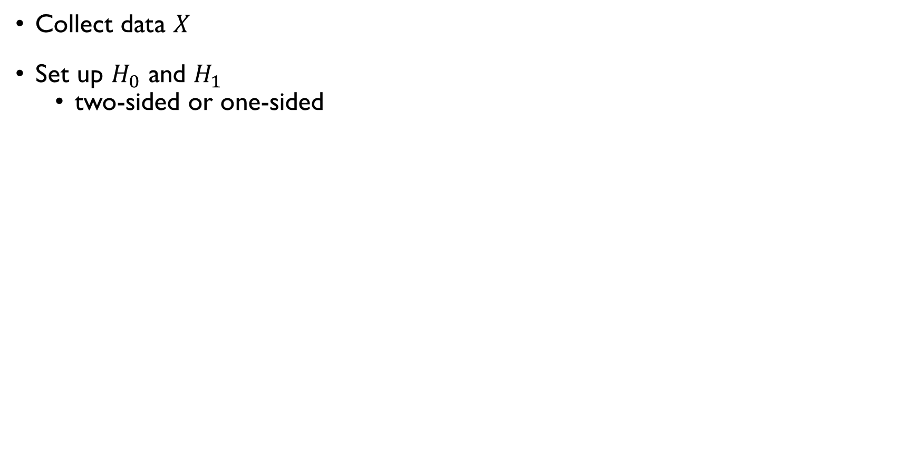
HYPOTHESIS TESTING STEP-BY-STEP
Collect data $X$
Set up $H_{0}$ and $H_{1}$
two-sided or one-sided
Chose test statistic $T\left(X\right)$
Determine distribution of $T$ assuming $H_{0}$
Determine rejection area $R$
Compute the value $t$ of $T\left(X\right)$ from data
Check if it falls into the rejection area $R$
YES $⟹$ reject $H_{0}$
NO $⟹$ don’t reject $H_{0}$

Slide 7
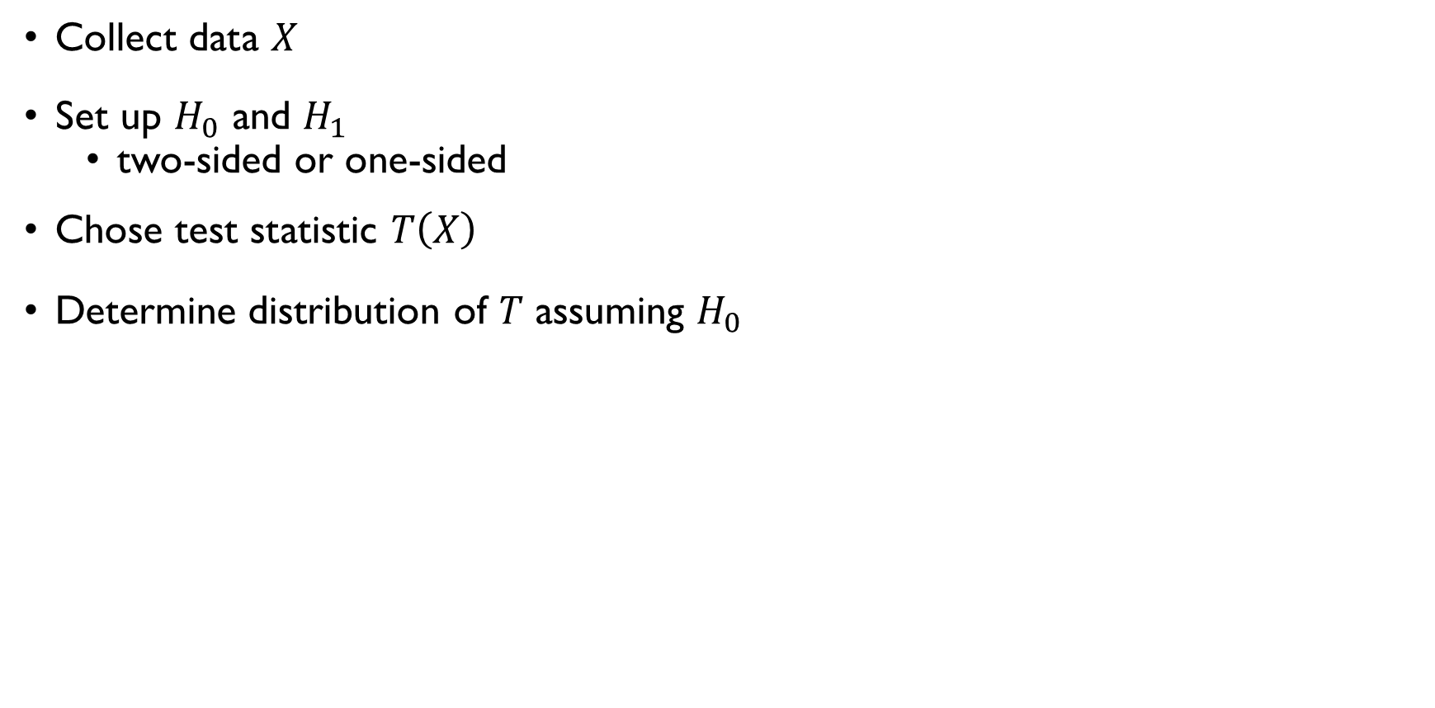
HYPOTHESIS TESTING STEP-BY-STEP
Collect data $X$
Set up $H_{0}$ and $H_{1}$
two-sided or one-sided
Chose test statistic $T\left(X\right)$
Determine distribution of $T$ assuming $H_{0}$
Determine rejection area $R$
Compute the value $t$ of $T\left(X\right)$ from data
Check if it falls into the rejection area $R$
YES $⟹$ reject $H_{0}$
NO $⟹$ don’t reject $H_{0}$

Slide 8
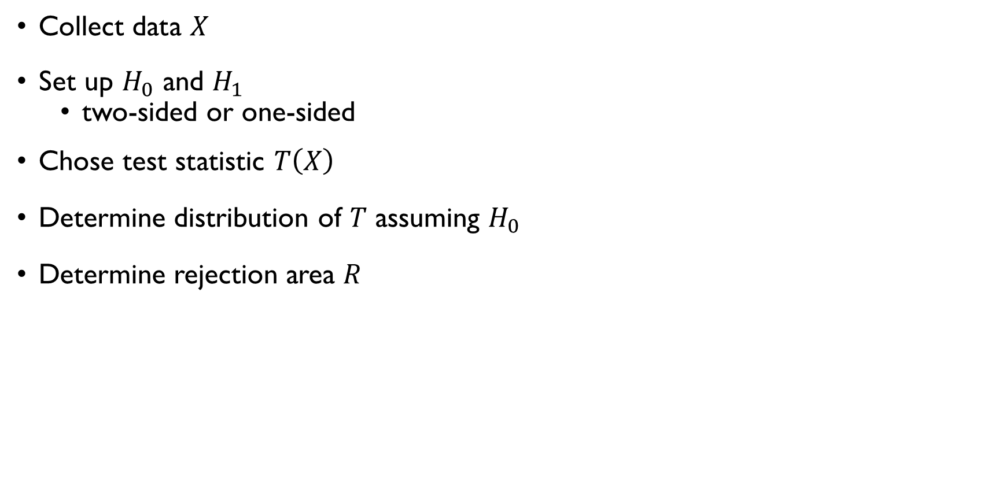
HYPOTHESIS TESTING STEP-BY-STEP
Collect data $X$
Set up $H_{0}$ and $H_{1}$
two-sided or one-sided
Chose test statistic $T\left(X\right)$
Determine distribution of $T$ assuming $H_{0}$
Determine rejection area $R$
Compute the value $t$ of $T\left(X\right)$ from data
Check if it falls into the rejection area $R$
YES $⟹$ reject $H_{0}$
NO $⟹$ don’t reject $H_{0}$

Slide 9
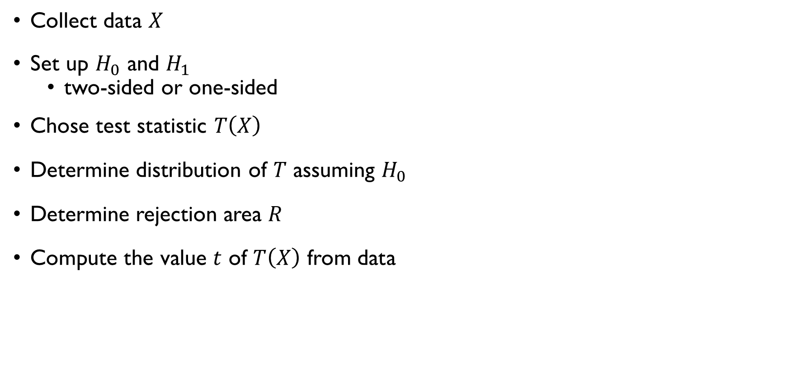
HYPOTHESIS TESTING STEP-BY-STEP
Collect data $X$
Set up $H_{0}$ and $H_{1}$
two-sided or one-sided
Chose test statistic $T\left(X\right)$
Determine distribution of $T$ assuming $H_{0}$
Determine rejection area $R$
Compute the value $t$ of $T\left(X\right)$ from data
Check if it falls into the rejection area $R$
YES $⟹$ reject $H_{0}$
NO $⟹$ don’t reject $H_{0}$

Slide 10
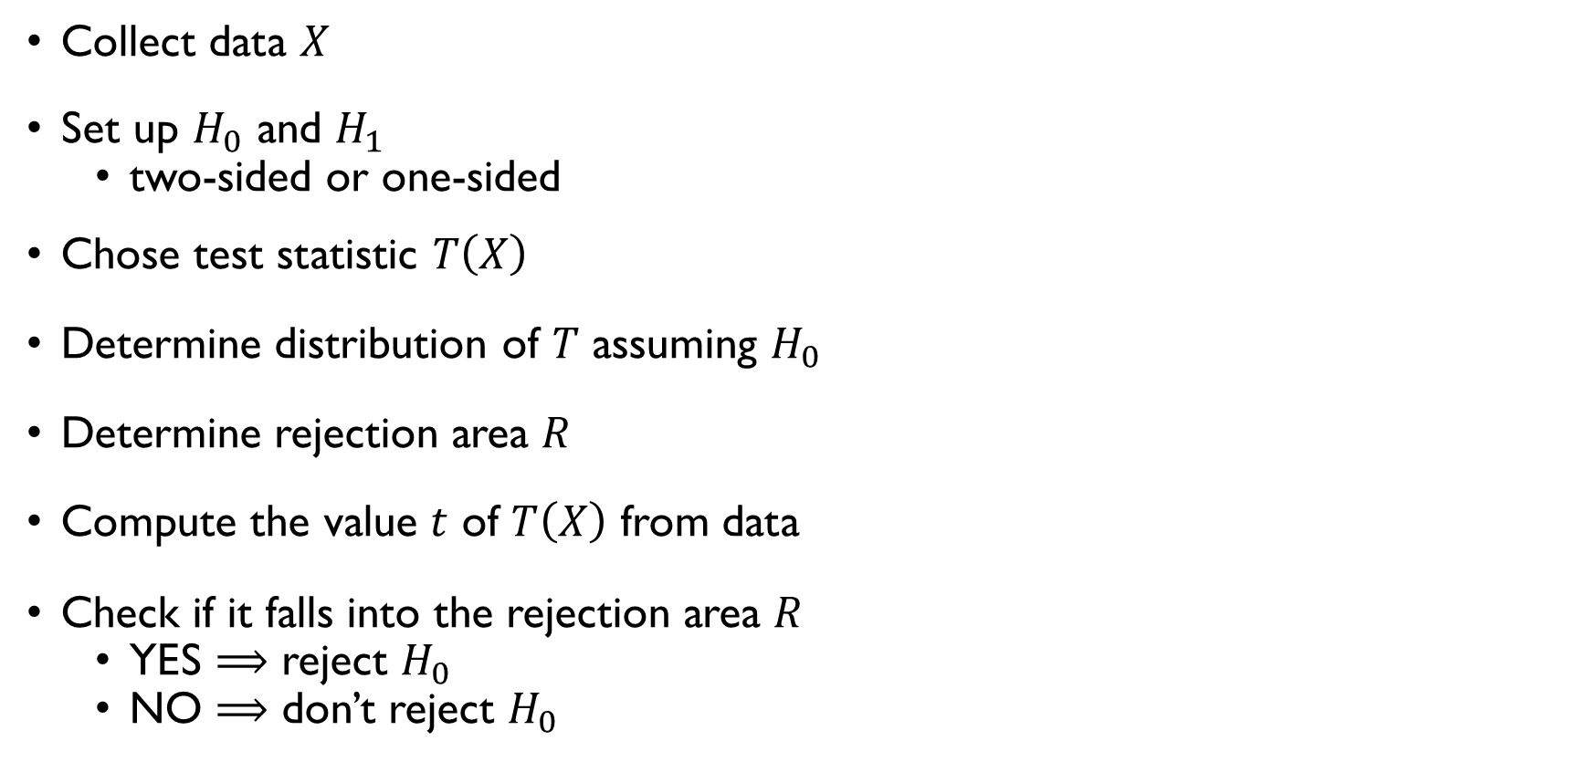
HYPOTHESIS TESTING STEP-BY-STEP
Collect data $X$
Set up $H_{0}$ and $H_{1}$
two-sided or one-sided
Chose test statistic $T\left(X\right)$
Determine distribution of $T$ assuming $H_{0}$
Determine rejection area $R$
Compute the value $t$ of $T\left(X\right)$ from data
Check if it falls into the rejection area $R$
YES $⟹$ reject $H_{0}$
NO $⟹$ don’t reject $H_{0}$

Slide 11
ONE-SAMPLE TESTS
Check if the mean of the data equals some hypothesized value assuming that the data is normal

Slide 12
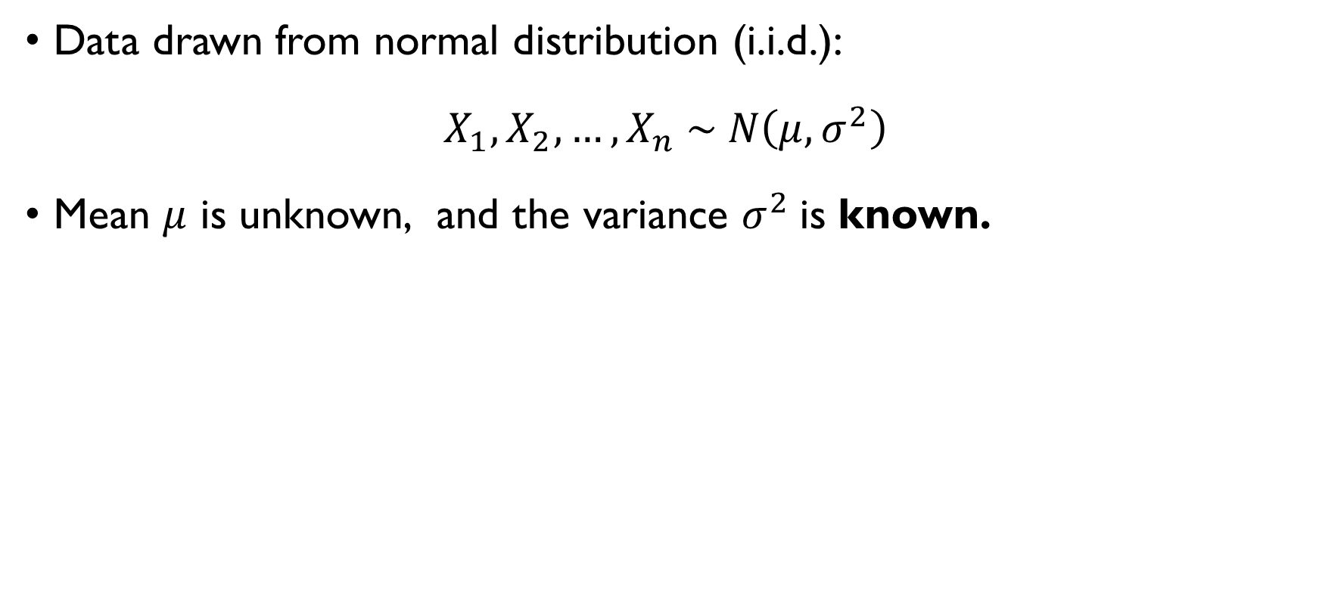
Z-TEST
Data drawn from normal distribution (i.i.d.):
$$X_{1},X_{2},…,X_{n} \sim N\left(μ,σ^{2}\right)$$
Mean $μ$ is unknown, and the variance $σ^{2}$is known.
Null hypothesis: $H_{0}: μ_{X}=μ_{0}$
Alternatives:
Two-sided: $H_{1}:μ_{X}≠μ_{0}$
One-sided: $H_{1}:μ>μ_{0}$ or $H_{1}:μ<μ_{0}$

Slide 13
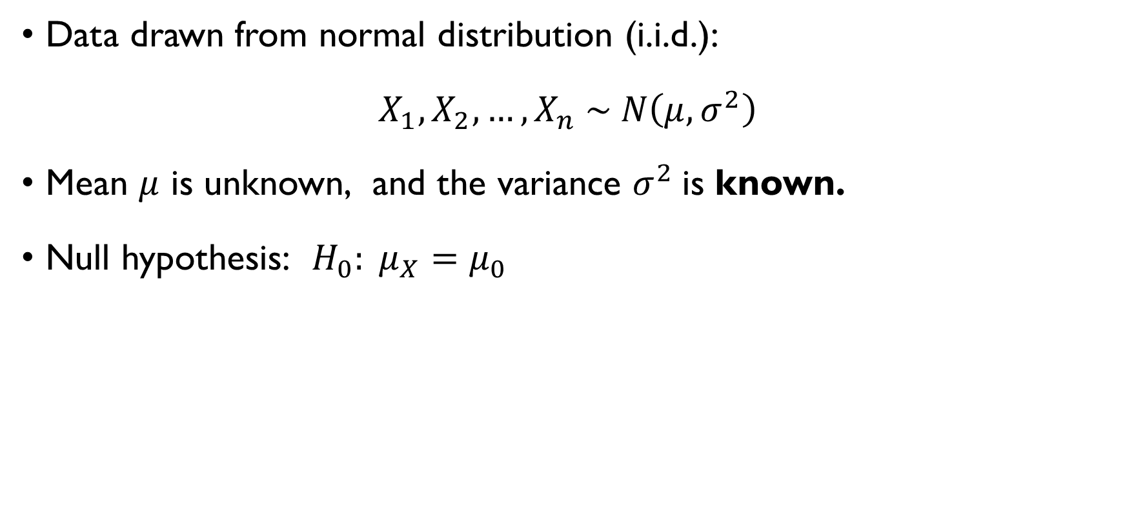
Z-TEST
Data drawn from normal distribution (i.i.d.):
$$X_{1},X_{2},…,X_{n} \sim N\left(μ,σ^{2}\right)$$
Mean $μ$ is unknown, and the variance $σ^{2}$is known.
Null hypothesis: $H_{0}: μ_{X}=μ_{0}$
Alternatives:
Two-sided: $H_{1}:μ_{X}≠μ_{0}$
One-sided: $H_{1}:μ>μ_{0}$ or $H_{1}:μ<μ_{0}$

Slide 14
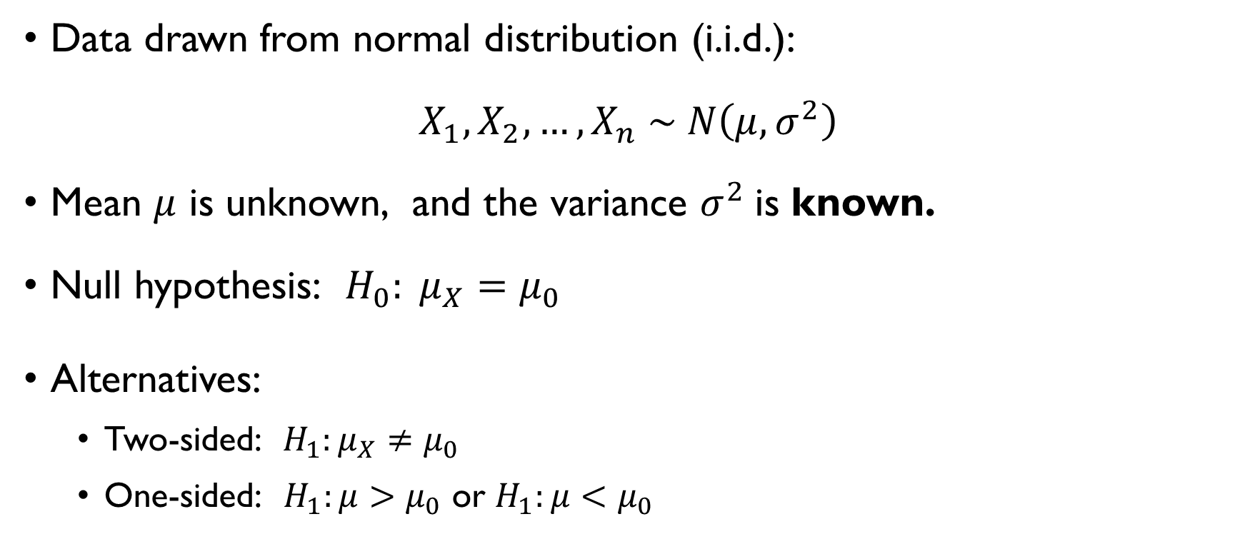
Z-TEST
Data drawn from normal distribution (i.i.d.):
$$X_{1},X_{2},…,X_{n} \sim N\left(μ,σ^{2}\right)$$
Mean $μ$ is unknown, and the variance $σ^{2}$is known.
Null hypothesis: $H_{0}: μ_{X}=μ_{0}$
Alternatives:
Two-sided: $H_{1}:μ_{X}≠μ_{0}$
One-sided: $H_{1}:μ>μ_{0}$ or $H_{1}:μ<μ_{0}$

Slide 15
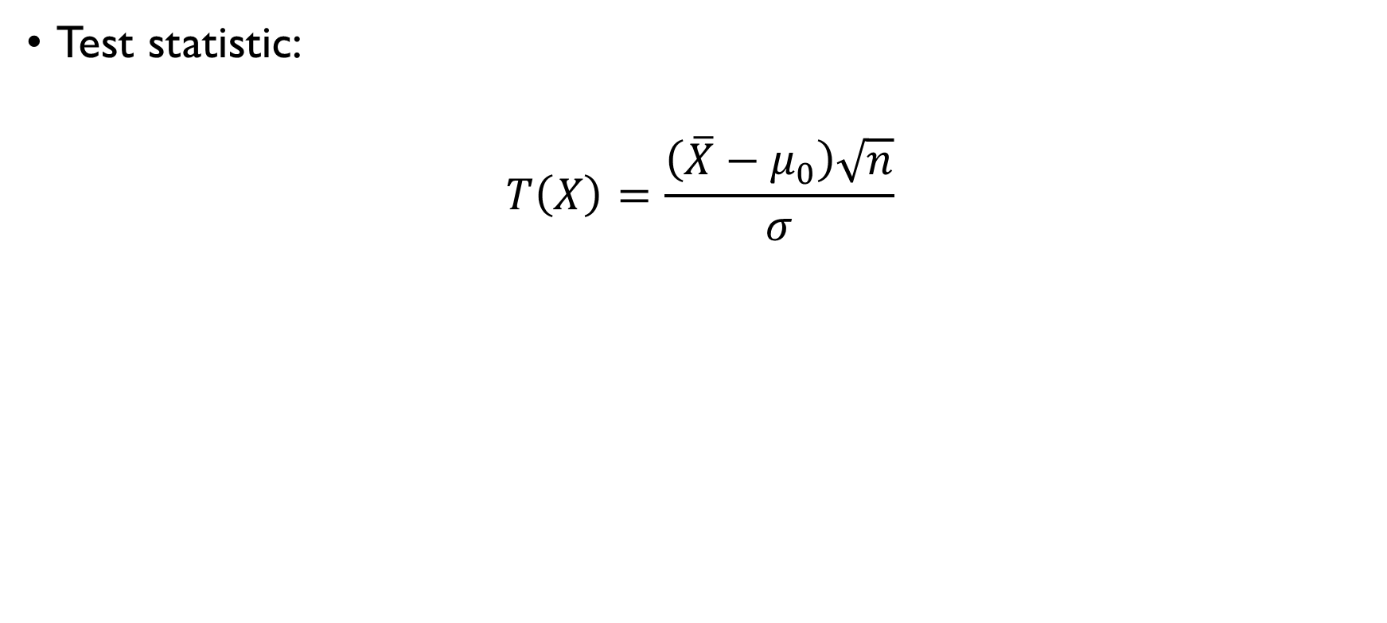
Z-TEST
Test statistic:
$$T\left(X\right)=\frac{\left(\overline{X}−μ_{0}\right)\sqrt{n}}{σ}$$
Null distribution:
$$\frac{\left(\overline{X}−μ_{0}\right)\sqrt{n}}{σ} \sim N\left(0,1\right)$$

Slide 16
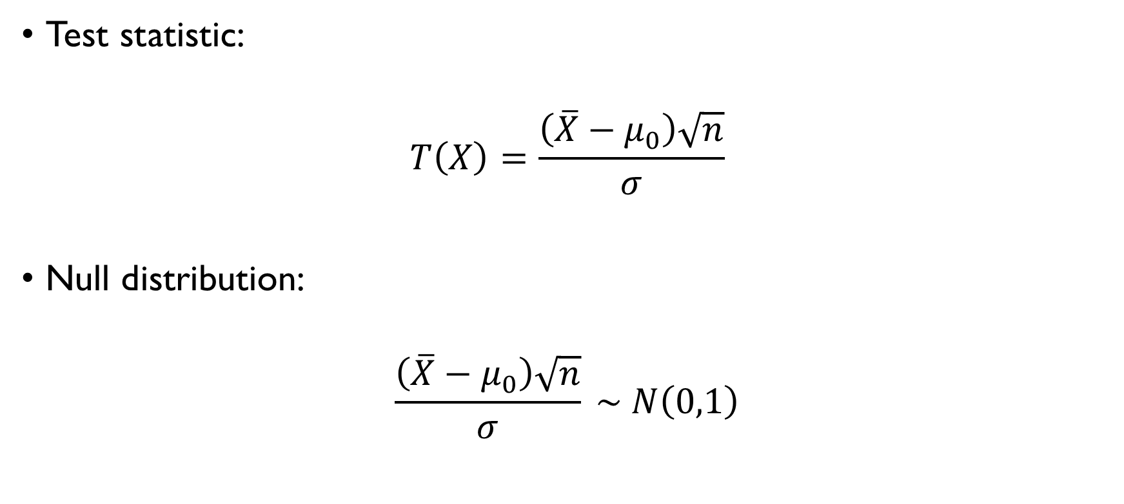
Z-TEST
Test statistic:
$$T\left(X\right)=\frac{\left(\overline{X}−μ_{0}\right)\sqrt{n}}{σ}$$
Null distribution:
$$\frac{\left(\overline{X}−μ_{0}\right)\sqrt{n}}{σ} \sim N\left(0,1\right)$$

Slide 17
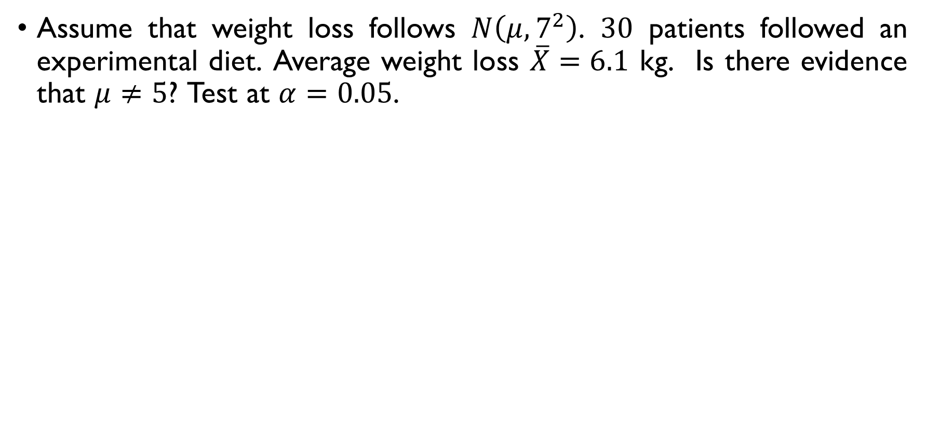
Z-TEST: EXAMPLE
Assume that weight loss follows $N\left(μ,7^{2}\right)$. $30$ patients followed an experimental diet. Average weight loss $\overline{X}=6.1$ kg. Is there evidence that $μ≠5$? Test at $α=0.05$.
$$H_{0}:μ=5, H_{1}:μ≠100$$
$$T\left(X\right)=\frac{\left(\overline{X}−μ_{0}\right)\sqrt{n}}{σ} \sim N\left(0,1\right), z_{1−0.025}=1.96$$
$T\left(X\right)=\frac{\left(6.1−5\right)\sqrt{30}}{7}=0.86, \left|T\left(X\right)\right|<1.96 ⟹$don’t reject $H_{0}$

Slide 18
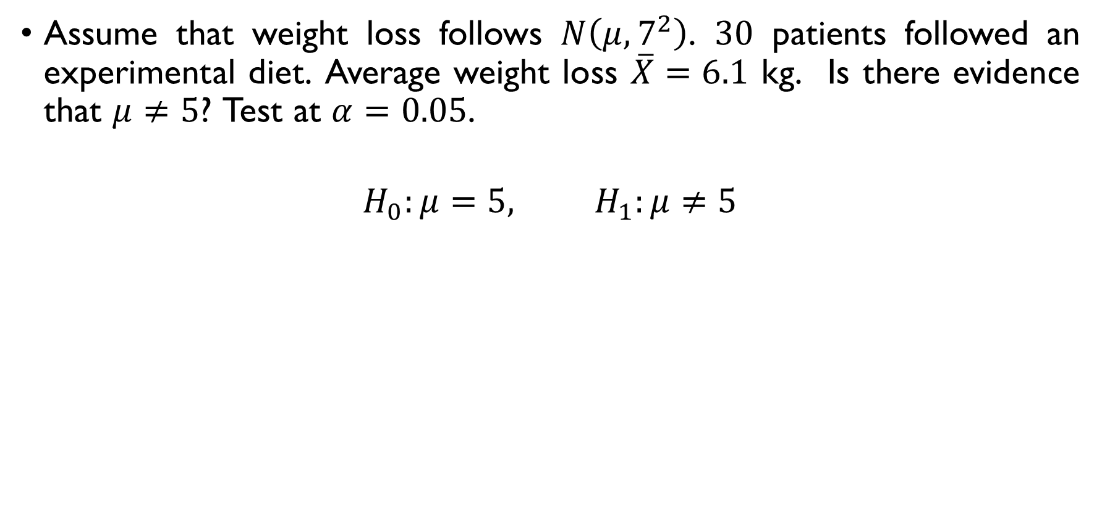
Z-TEST: EXAMPLE
Assume that weight loss follows $N\left(μ,7^{2}\right)$. $30$ patients followed an experimental diet. Average weight loss $\overline{X}=6.1$ kg. Is there evidence that $μ≠5$? Test at $α=0.05$.
$$H_{0}:μ=5, H_{1}:μ≠5$$
$$T\left(X\right)=\frac{\left(\overline{X}−μ_{0}\right)\sqrt{n}}{σ} \sim N\left(0,1\right), z_{1−0.025}=1.96$$
$T\left(X\right)=\frac{\left(6.1−5\right)\sqrt{30}}{7}=0.86, \left|T\left(X\right)\right|<1.96 ⟹$don’t reject $H_{0}$

Slide 19
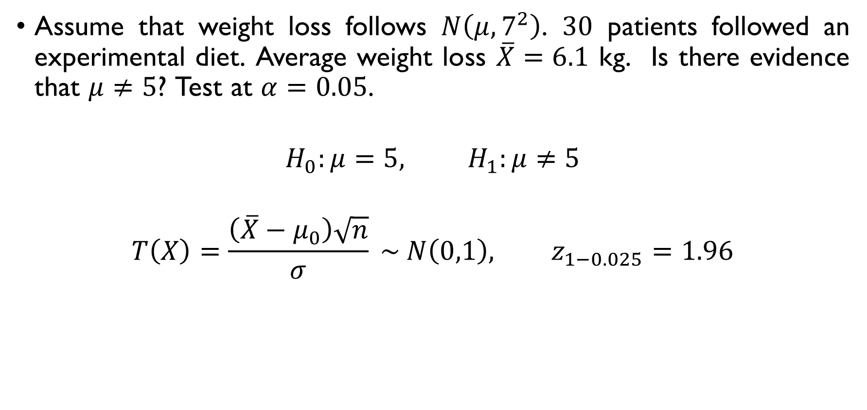
Z-TEST: EXAMPLE
Assume that weight loss follows $N\left(μ,7^{2}\right)$. $30$ patients followed an experimental diet. Average weight loss $\overline{X}=6.1$ kg. Is there evidence that $μ≠5$? Test at $α=0.05$.
$$H_{0}:μ=5, H_{1}:μ≠5$$
$$T\left(X\right)=\frac{\left(\overline{X}−μ_{0}\right)\sqrt{n}}{σ} \sim N\left(0,1\right), z_{1−0.025}=1.96$$
$T\left(X\right)=\frac{\left(6.1−5\right)\sqrt{30}}{7}=0.86, \left|T\left(X\right)\right|<1.96 ⟹$don’t reject $H_{0}$

Slide 20
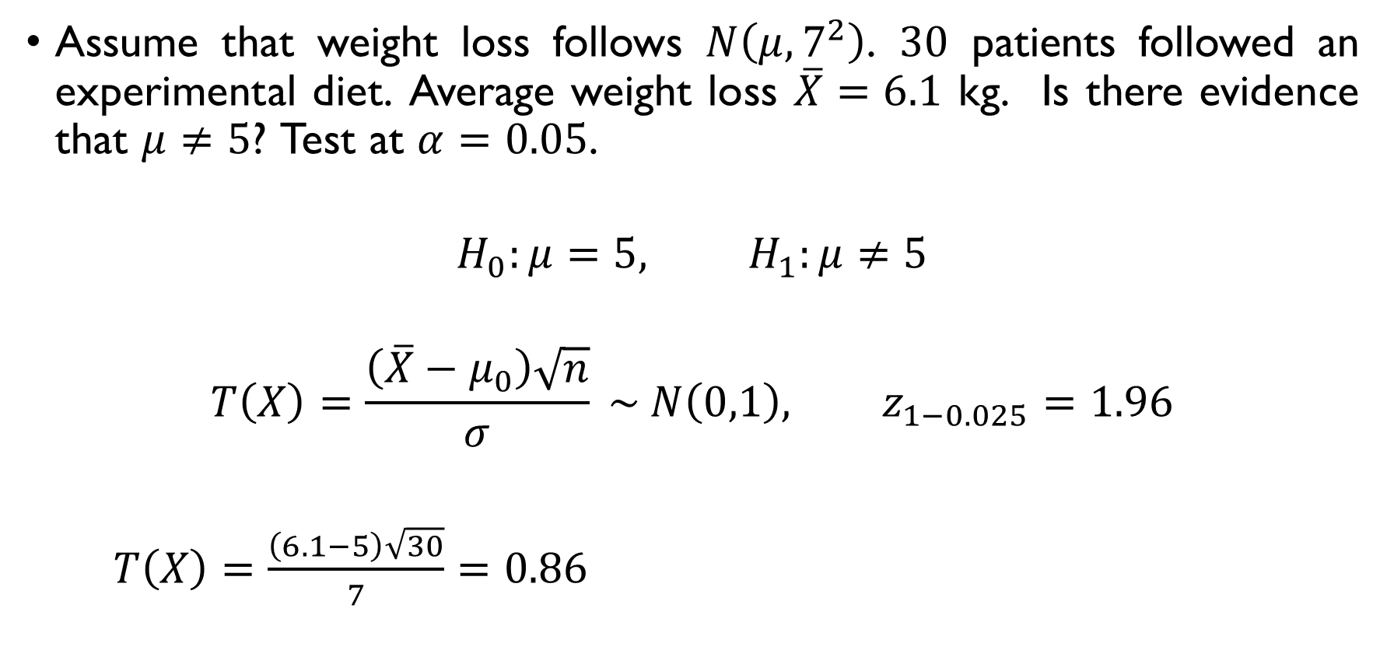
Z-TEST: EXAMPLE
Assume that weight loss follows $N\left(μ,7^{2}\right)$. $30$ patients followed an experimental diet. Average weight loss $\overline{X}=6.1$ kg. Is there evidence that $μ≠5$? Test at $α=0.05$.
$$H_{0}:μ=5, H_{1}:μ≠5$$
$$T\left(X\right)=\frac{\left(\overline{X}−μ_{0}\right)\sqrt{n}}{σ} \sim N\left(0,1\right), z_{1−0.025}=1.96$$
$T\left(X\right)=\frac{\left(6.1−5\right)\sqrt{30}}{7}=0.86, \left|T\left(X\right)\right|<1.96 ⟹$don’t reject $H_{0}$

Slide 21
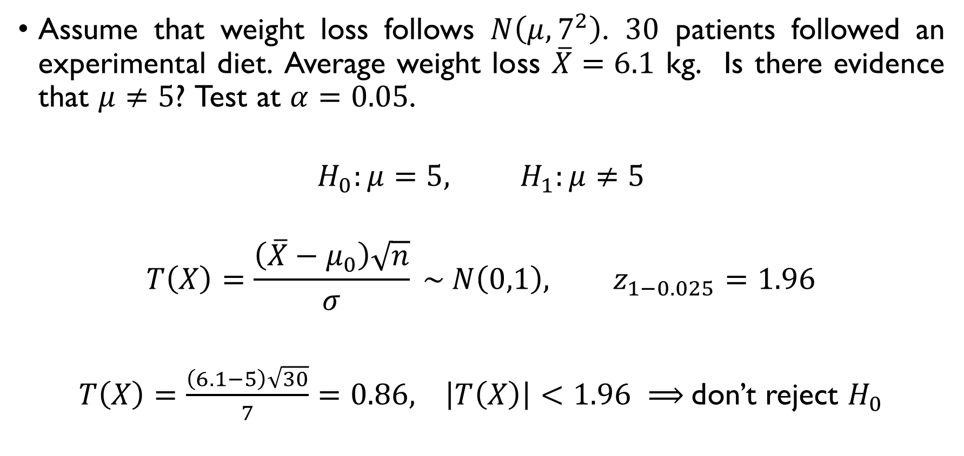
Z-TEST: EXAMPLE
Assume that weight loss follows $N\left(μ,7^{2}\right)$. $30$ patients followed an experimental diet. Average weight loss $\overline{X}=6.1$ kg. Is there evidence that $μ≠5$? Test at $α=0.05$.
$$H_{0}:μ=5, H_{1}:μ≠5$$
$$T\left(X\right)=\frac{\left(\overline{X}−μ_{0}\right)\sqrt{n}}{σ} \sim N\left(0,1\right), z_{1−0.025}=1.96$$
$T\left(X\right)=\frac{\left(6.1−5\right)\sqrt{30}}{7}=0.86, \left|T\left(X\right)\right|<1.96 ⟹$don’t reject $H_{0}$

Slide 22
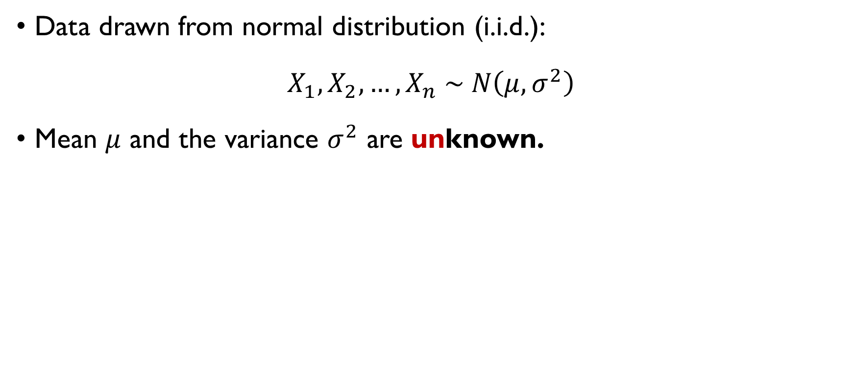
T-TEST
Data drawn from normal distribution (i.i.d.):
$$X_{1},X_{2},…,X_{n} \sim N\left(μ,σ^{2}\right)$$
Mean $μ$ and the variance $σ^{2}$ are unknown.
Null hypothesis: $H_{0}: μ_{X}=μ_{0}$
Alternatives:
Two-sided: $H_{1}:μ_{X}≠μ_{0}$
One-sided: $H_{1}:μ>μ_{0}$ or $H_{1}:μ<μ_{0}$

Slide 23
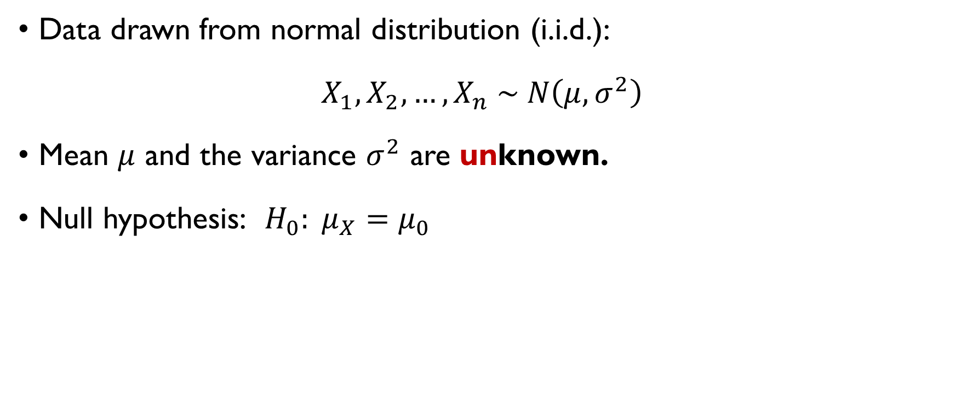
T-TEST
Data drawn from normal distribution (i.i.d.):
$$X_{1},X_{2},…,X_{n} \sim N\left(μ,σ^{2}\right)$$
Mean $μ$ and the variance $σ^{2}$ are unknown.
Null hypothesis: $H_{0}: μ_{X}=μ_{0}$
Alternatives:
Two-sided: $H_{1}:μ_{X}≠μ_{0}$
One-sided: $H_{1}:μ>μ_{0}$ or $H_{1}:μ<μ_{0}$

Slide 24
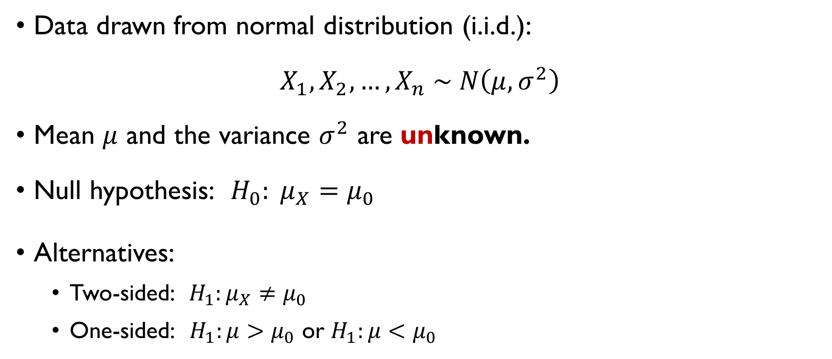
T-TEST
Data drawn from normal distribution (i.i.d.):
$$X_{1},X_{2},…,X_{n} \sim N\left(μ,σ^{2}\right)$$
Mean $μ$ and the variance $σ^{2}$ are unknown.
Null hypothesis: $H_{0}: μ_{X}=μ_{0}$
Alternatives:
Two-sided: $H_{1}:μ_{X}≠μ_{0}$
One-sided: $H_{1}:μ>μ_{0}$ or $H_{1}:μ<μ_{0}$

Slide 25
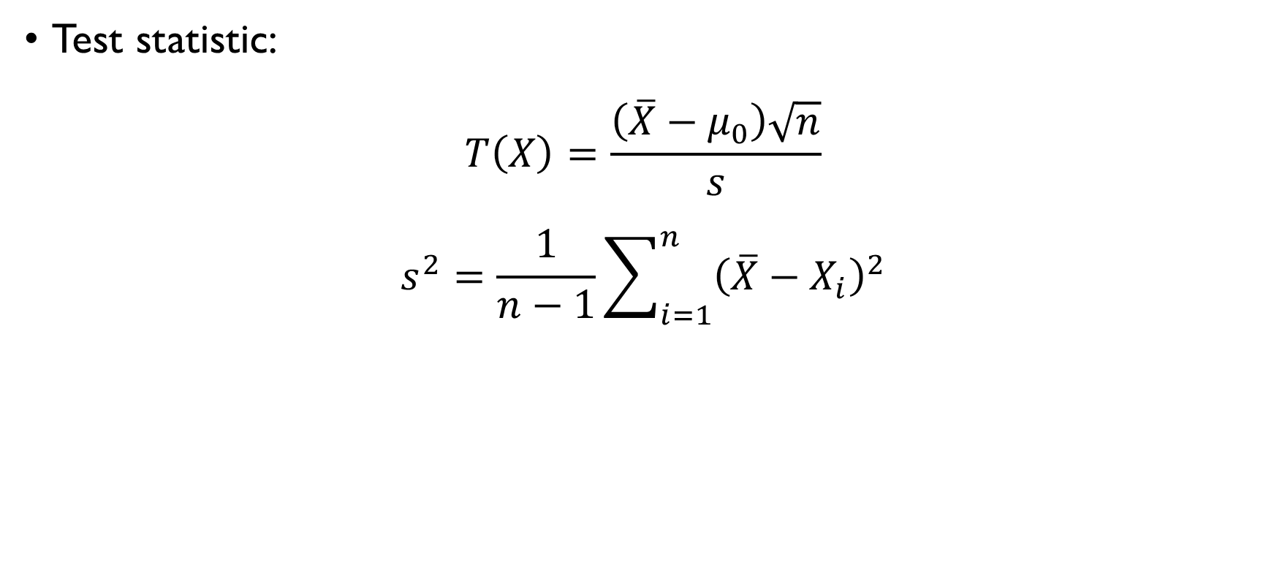
T-TEST
Test statistic:
$$T\left(X\right)=\frac{\left(\overline{X}−μ_{0}\right)\sqrt{n}}{s}$$
$$s^{2}=\frac{1}{n−1}\sum_{i=1}^{n}{{\left(\overline{X}−X_{i}\right)}^{2}}$$
Null distribution:
$$\frac{\left(\overline{X}−μ_{0}\right)\sqrt{n}}{s} \sim t\left(n−1\right)$$

Slide 26
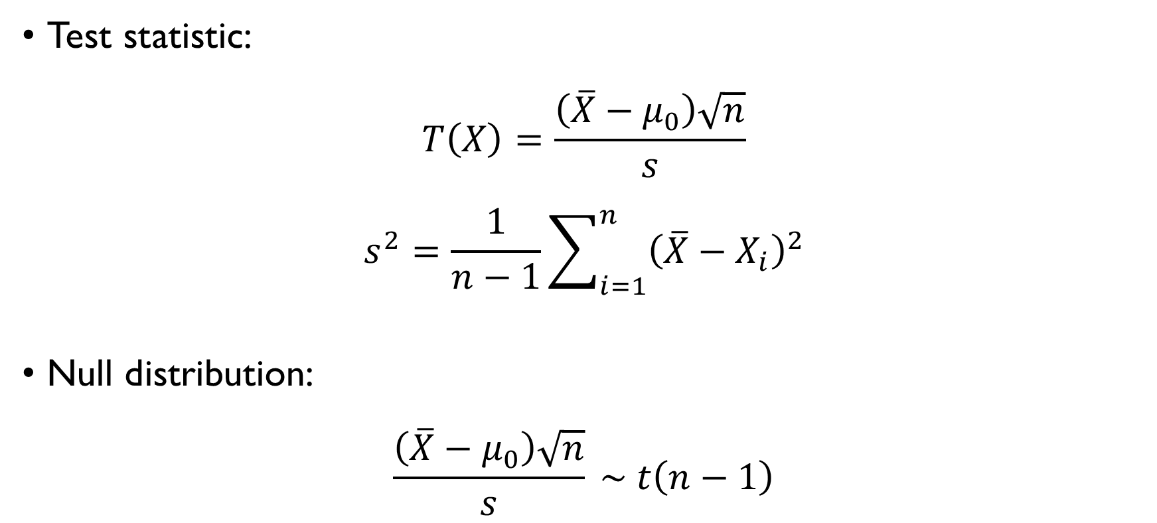
T-TEST
Test statistic:
$$T\left(X\right)=\frac{\left(\overline{X}−μ_{0}\right)\sqrt{n}}{s}$$
$$s^{2}=\frac{1}{n−1}\sum_{i=1}^{n}{{\left(\overline{X}−X_{i}\right)}^{2}}$$
Null distribution:
$$\frac{\left(\overline{X}−μ_{0}\right)\sqrt{n}}{s} \sim t\left(n−1\right)$$

Slide 27
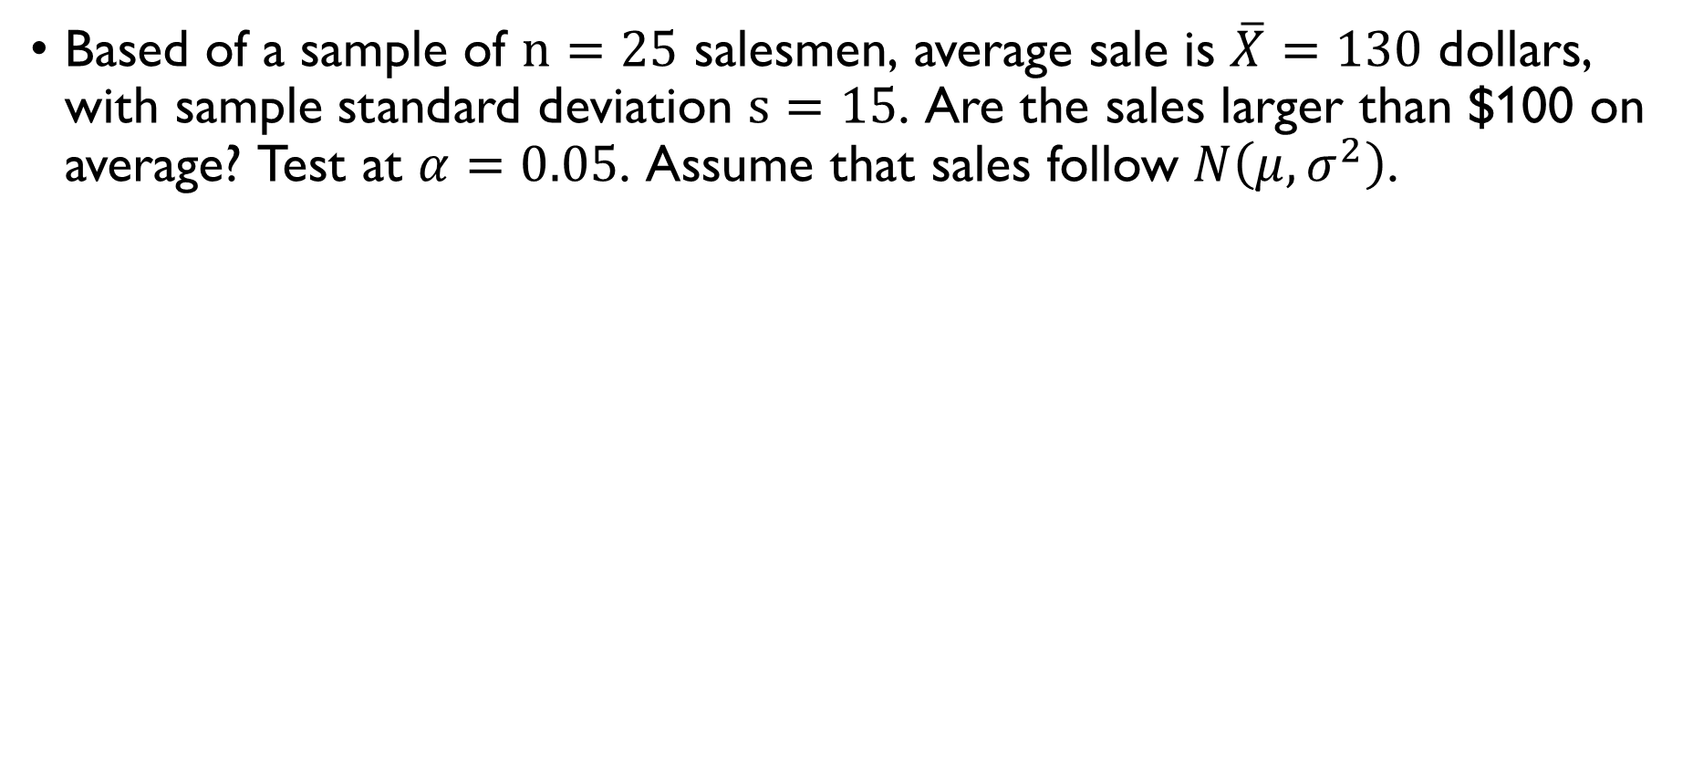
T-TEST: EXAMPLE
Based of a sample of $n=25$ salesmen, average sale is $\overline{X}=130$ dollars, with sample standard deviation $s=15$. Are the sales larger than $100 on average? Test at $α=0.05$. Assume that sales follow $N\left(μ,σ^{2}\right)$.
$$H_{0}:μ=100, H_{1}:μ>100$$
$$T\left(X\right)=\frac{\left(\overline{X}−μ_{0}\right)\sqrt{n}}{s} \sim t\left(24\right), t_{1−0.05}\left(24\right)=1.711$$
$T\left(X\right)=\frac{\left(130−100\right)\sqrt{25}}{15}=10>1.711 ⟹$reject $H_{0}$

Slide 28
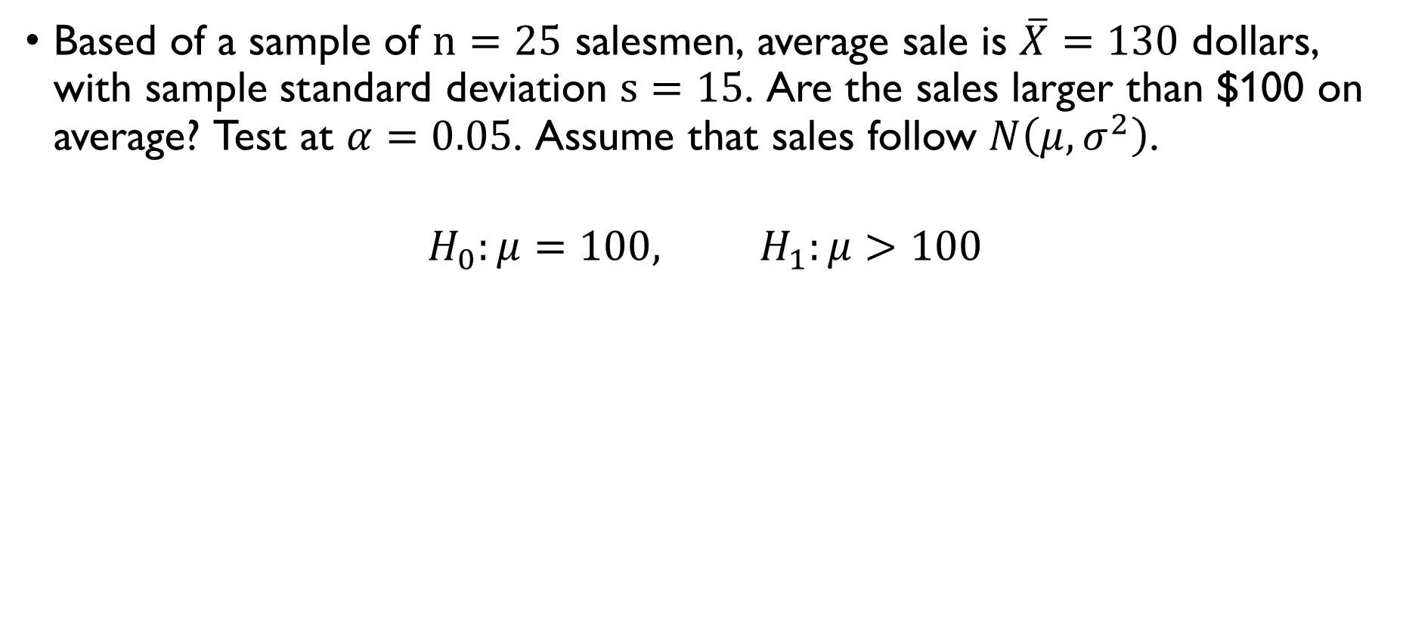
T-TEST: EXAMPLE
Based of a sample of $n=25$ salesmen, average sale is $\overline{X}=130$ dollars, with sample standard deviation $s=15$. Are the sales larger than $100 on average? Test at $α=0.05$. Assume that sales follow $N\left(μ,σ^{2}\right)$.
$$H_{0}:μ=100, H_{1}:μ>100$$
$$T\left(X\right)=\frac{\left(\overline{X}−μ_{0}\right)\sqrt{n}}{s} \sim t\left(24\right), t_{1−0.05}\left(24\right)=1.711$$
$T\left(X\right)=\frac{\left(130−100\right)\sqrt{25}}{15}=10>1.711 ⟹$reject $H_{0}$

Slide 29
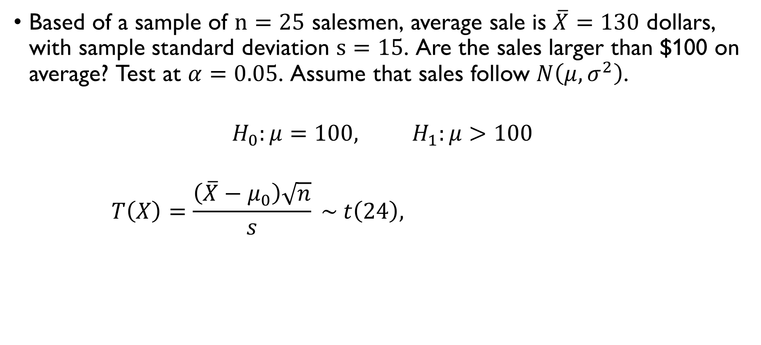
T-TEST: EXAMPLE
Based of a sample of $n=25$ salesmen, average sale is $\overline{X}=130$ dollars, with sample standard deviation $s=15$. Are the sales larger than $100 on average? Test at $α=0.05$. Assume that sales follow $N\left(μ,σ^{2}\right)$.
$$H_{0}:μ=100, H_{1}:μ>100$$
$$T\left(X\right)=\frac{\left(\overline{X}−μ_{0}\right)\sqrt{n}}{s} \sim t\left(24\right), t_{1−0.05}\left(24\right)=1.711$$
$T\left(X\right)=\frac{\left(130−100\right)\sqrt{25}}{15}=10>1.711 ⟹$reject $H_{0}$

Slide 30
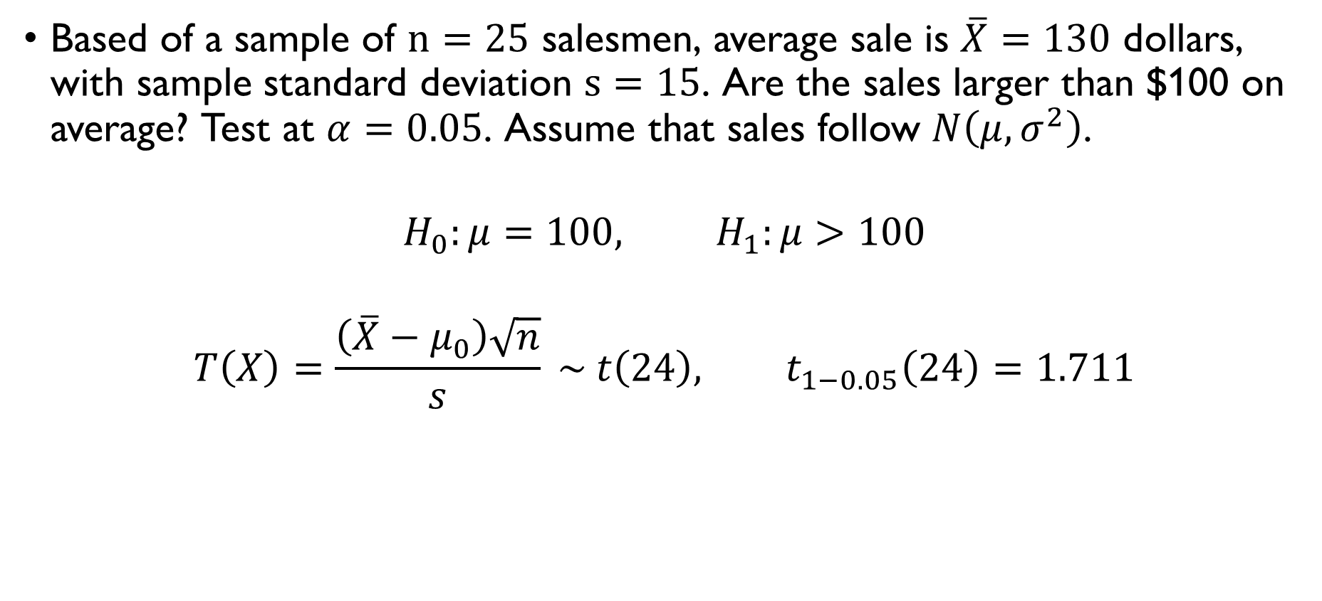
T-TEST: EXAMPLE
Based of a sample of $n=25$ salesmen, average sale is $\overline{X}=130$ dollars, with sample standard deviation $s=15$. Are the sales larger than $100 on average? Test at $α=0.05$. Assume that sales follow $N\left(μ,σ^{2}\right)$.
$$H_{0}:μ=100, H_{1}:μ>100$$
$$T\left(X\right)=\frac{\left(\overline{X}−μ_{0}\right)\sqrt{n}}{s} \sim t\left(24\right), t_{1−0.05}\left(24\right)=1.711$$
$T\left(X\right)=\frac{\left(130−100\right)\sqrt{25}}{15}=10>1.711 ⟹$reject $H_{0}$

Slide 31
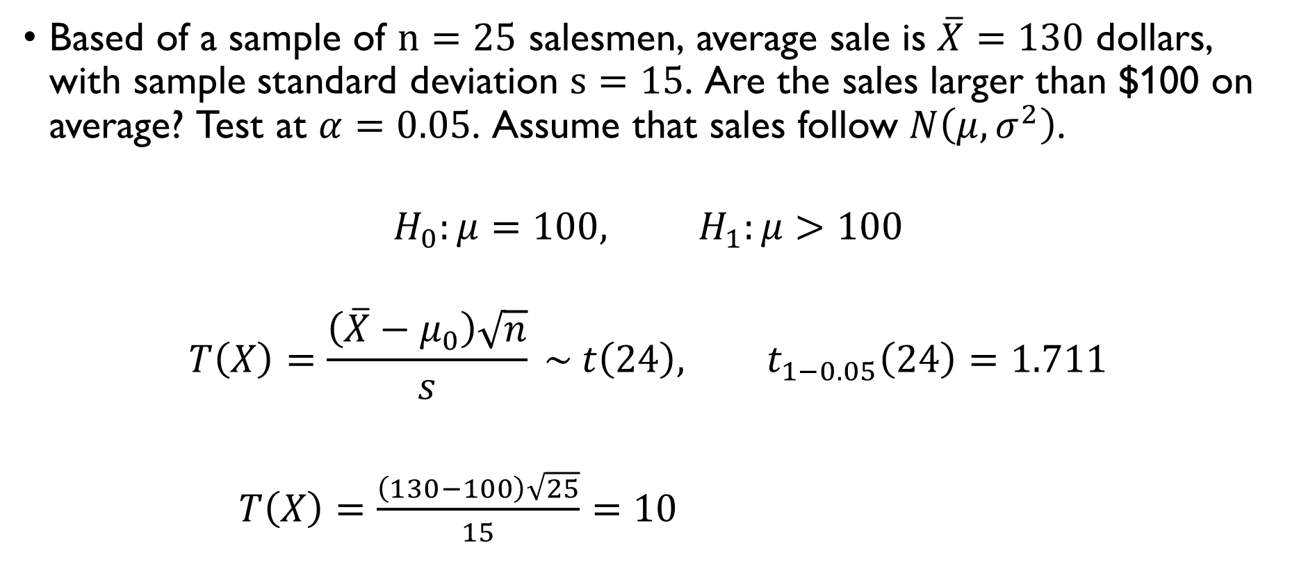
T-TEST: EXAMPLE
Based of a sample of $n=25$ salesmen, average sale is $\overline{X}=130$ dollars, with sample standard deviation $s=15$. Are the sales larger than $100 on average? Test at $α=0.05$. Assume that sales follow $N\left(μ,σ^{2}\right)$.
$$H_{0}:μ=100, H_{1}:μ>100$$
$$T\left(X\right)=\frac{\left(\overline{X}−μ_{0}\right)\sqrt{n}}{s} \sim t\left(24\right), t_{1−0.05}\left(24\right)=1.711$$
$T\left(X\right)=\frac{\left(130−100\right)\sqrt{25}}{15}=10>1.711 ⟹$reject $H_{0}$

Slide 32
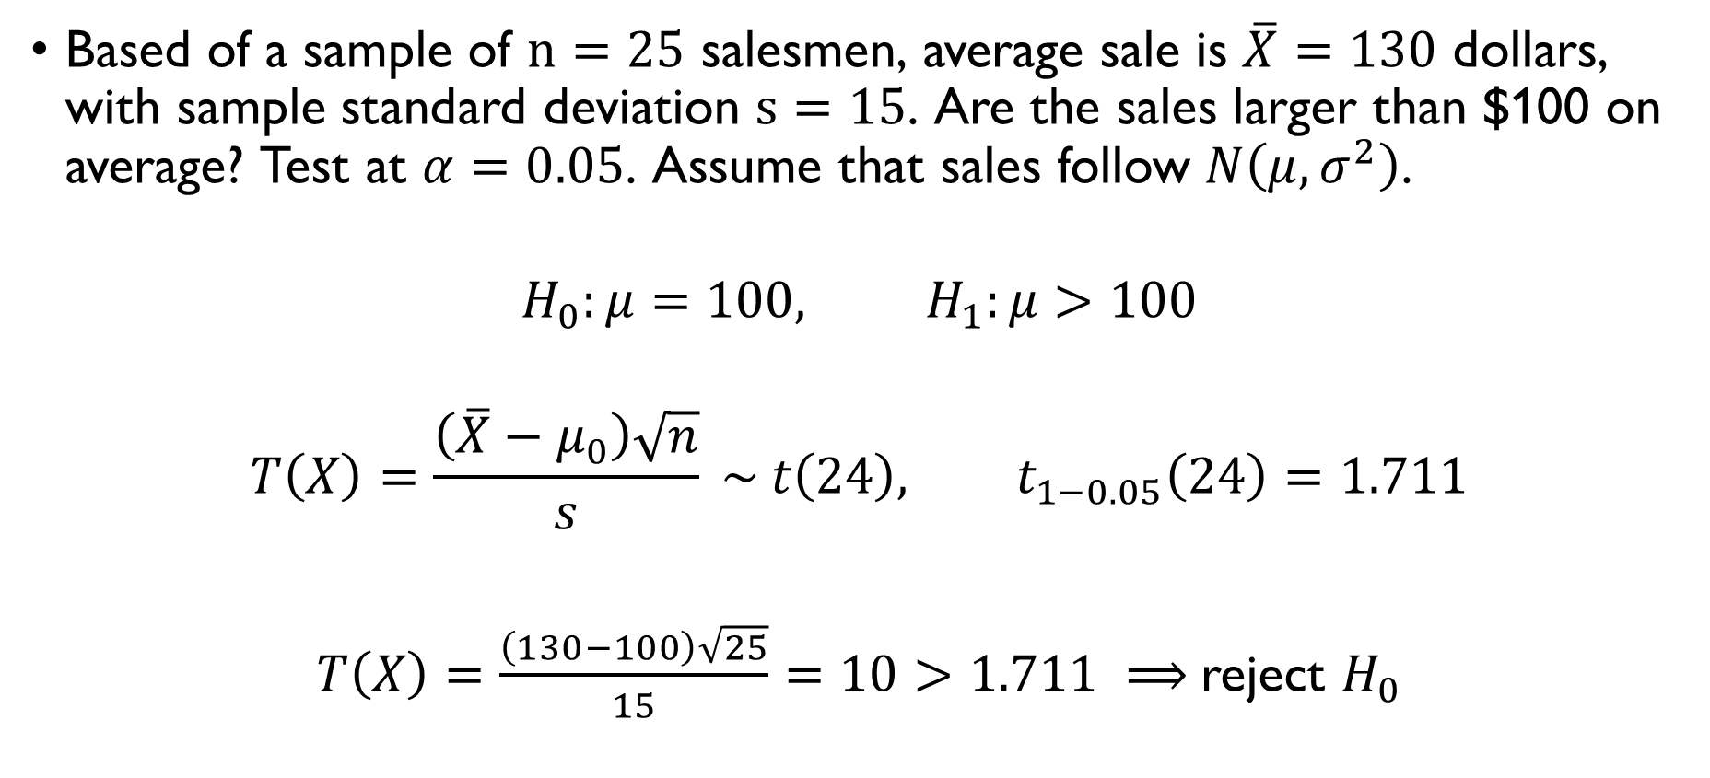
T-TEST: EXAMPLE
Based of a sample of $n=25$ salesmen, average sale is $\overline{X}=130$ dollars, with sample standard deviation $s=15$. Are the sales larger than $100 on average? Test at $α=0.05$. Assume that sales follow $N\left(μ,σ^{2}\right)$.
$$H_{0}:μ=100, H_{1}:μ>100$$
$$T\left(X\right)=\frac{\left(\overline{X}−μ_{0}\right)\sqrt{n}}{s} \sim t\left(24\right), t_{1−0.05}\left(24\right)=1.711$$
$T\left(X\right)=\frac{\left(130−100\right)\sqrt{25}}{15}=10>1.711 ⟹$reject $H_{0}$

Slide 33
TYPES OF ERRORS

Slide 34
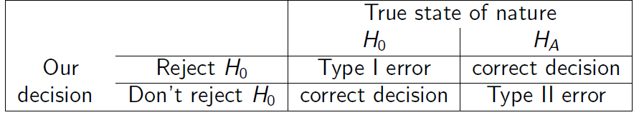

TYPES OF ERRORS
Significance level:
$$α=P\left(Type I error\right)=P\left(Reject H_{0} | H_{0}\right)=P\left(T∈R | H_{0}\right)$$
Power:
$$P\left(Reject H_{0} | H_{1}\right)=P\left(T∈R | H_{1}\right)=1−P\left(Type II error\right)$$
We want power near 1 and significance near 0

Slide 35
TYPES OF ERRORS
Significance level:
$$α=P\left(Type I error\right)=P\left(Reject H_{0} | H_{0}\right)=P\left(T∈R | H_{0}\right)$$
Power:
$$P\left(Reject H_{0} | H_{1}\right)=P\left(T∈R | H_{1}\right)=1−P\left(Type II error\right)$$
We want power near 1 and significance near 0

Slide 36
TYPES OF ERRORS
Significance level:
$$α=P\left(Type I error\right)=P\left(Reject H_{0} | H_{0}\right)=P\left(T∈R | H_{0}\right)$$
Power:
$$P\left(Reject H_{0} | H_{1}\right)=P\left(T∈R | H_{1}\right)=1−P\left(Type II error\right)$$
We want power near 1 and significance near 0

Slide 37
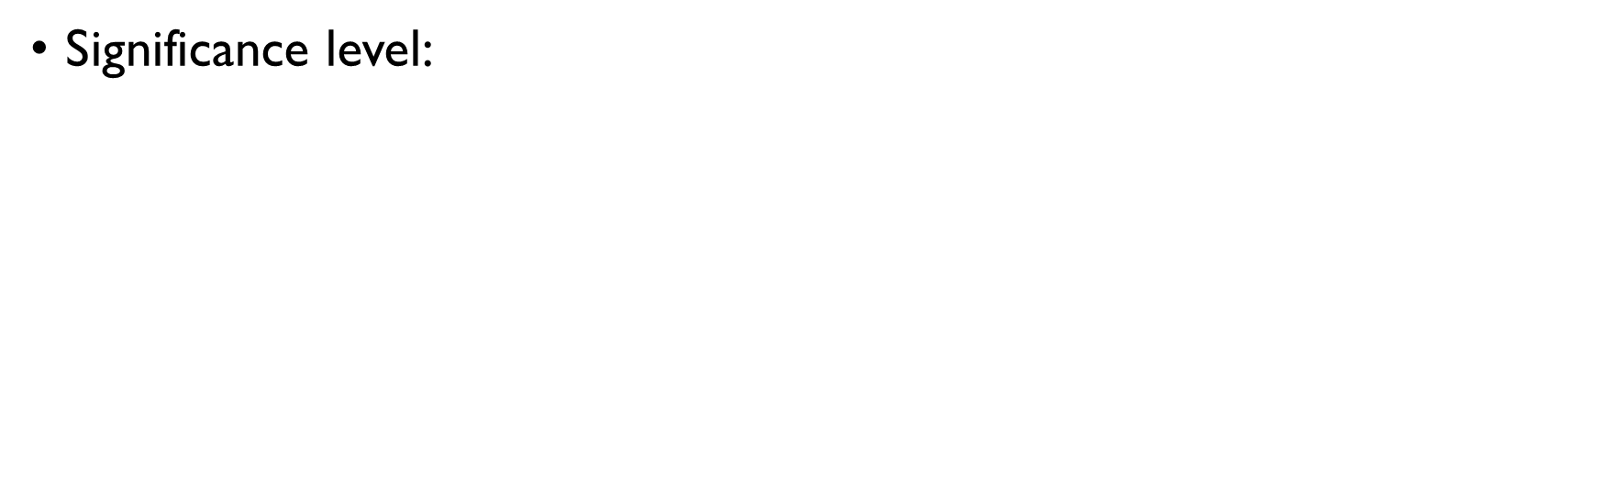
TYPES OF ERRORS
Significance level:
$$α=P\left(Type I error\right)=P\left(Reject H_{0} | H_{0}\right)=P\left(T∈R | H_{0}\right)$$
Power:
$$P\left(Reject H_{0} | H_{1}\right)=P\left(T∈R | H_{1}\right)=1−P\left(Type II error\right)$$
We want power near 1 and significance near 0

Slide 38
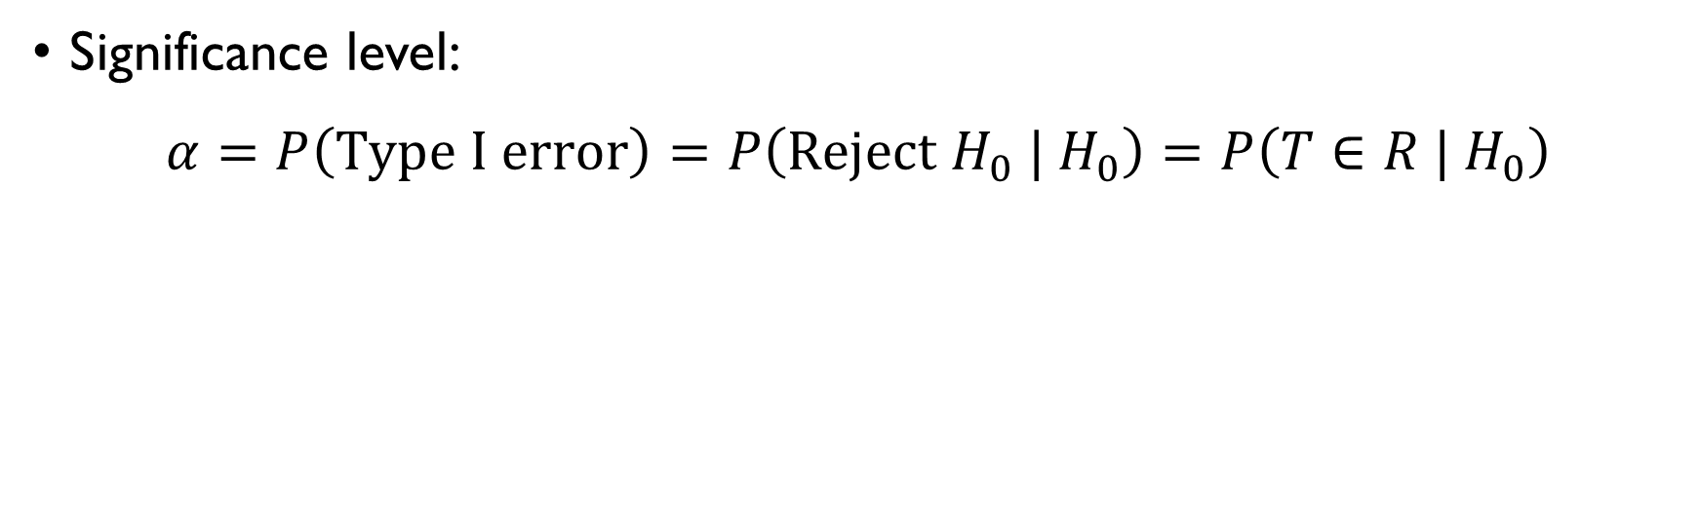
TYPES OF ERRORS
Significance level:
$$α=P\left(Type I error\right)=P\left(Reject H_{0} | H_{0}\right)=P\left(T∈R | H_{0}\right)$$
Power:
$$P\left(Reject H_{0} | H_{1}\right)=P\left(T∈R | H_{1}\right)=1−P\left(Type II error\right)$$
We want power near 1 and significance near 0

Slide 39
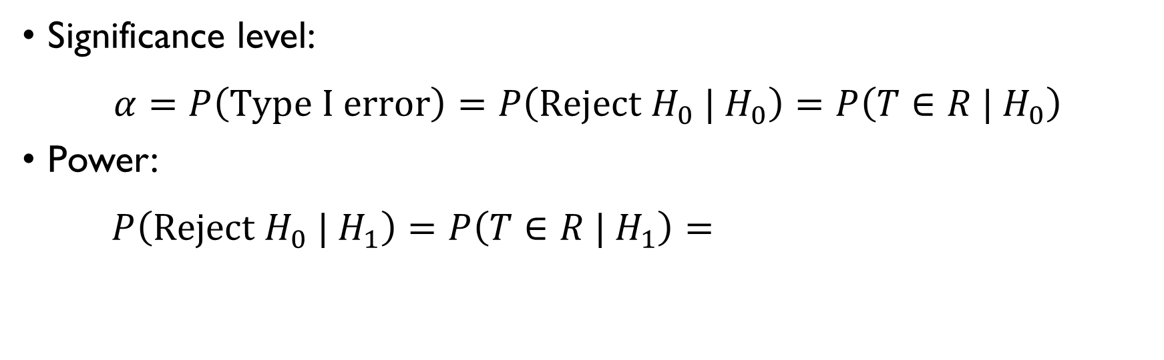
TYPES OF ERRORS
Significance level:
$$α=P\left(Type I error\right)=P\left(Reject H_{0} | H_{0}\right)=P\left(T∈R | H_{0}\right)$$
Power:
$$P\left(Reject H_{0} | H_{1}\right)=P\left(T∈R | H_{1}\right)=1−P\left(Type II error\right)$$
We want power near 1 and significance near 0

Slide 40
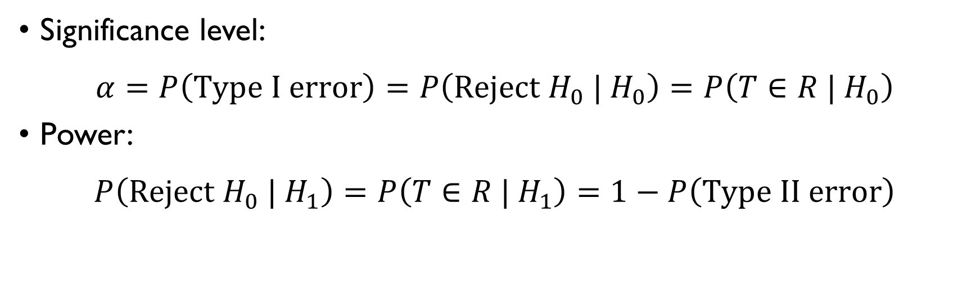
TYPES OF ERRORS
Significance level:
$$α=P\left(Type I error\right)=P\left(Reject H_{0} | H_{0}\right)=P\left(T∈R | H_{0}\right)$$
Power:
$$P\left(Reject H_{0} | H_{1}\right)=P\left(T∈R | H_{1}\right)=1−P\left(Type II error\right)$$
We want power near 1 and significance near 0

Slide 41
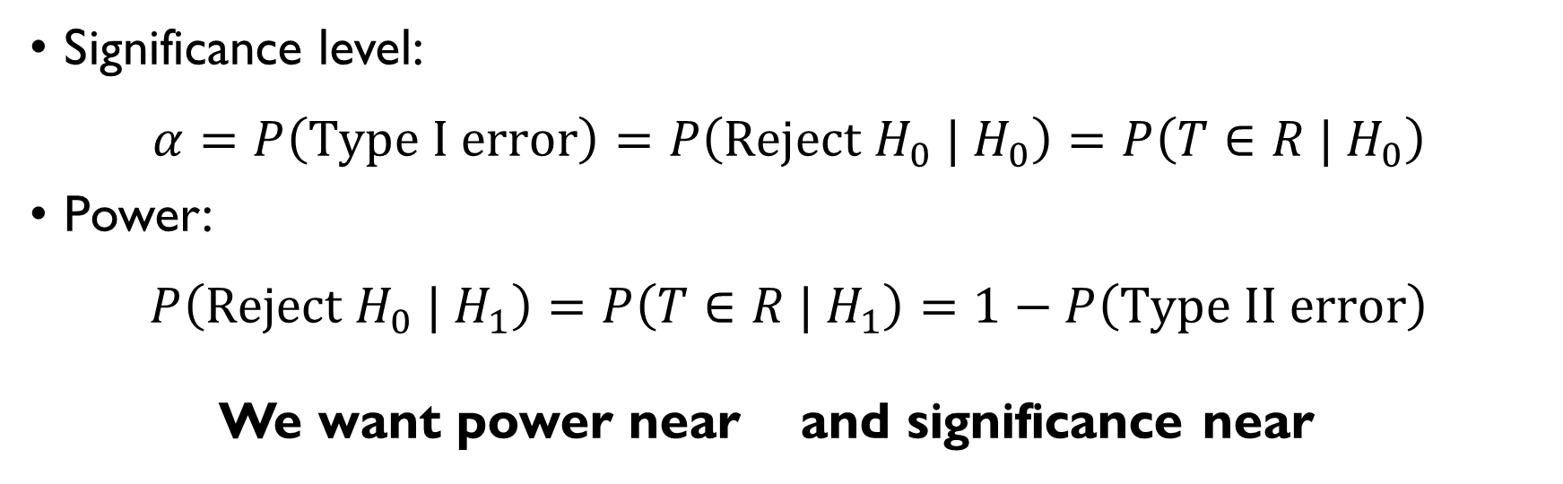
TYPES OF ERRORS
Significance level:
$$α=P\left(Type I error\right)=P\left(Reject H_{0} | H_{0}\right)=P\left(T∈R | H_{0}\right)$$
Power:
$$P\left(Reject H_{0} | H_{1}\right)=P\left(T∈R | H_{1}\right)=1−P\left(Type II error\right)$$
We want power near 1 and significance near 0

Slide 42
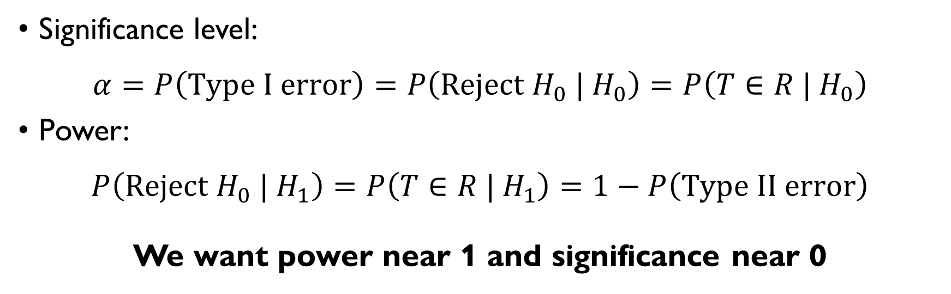
TYPES OF ERRORS
Significance level:
$$α=P\left(Type I error\right)=P\left(Reject H_{0} | H_{0}\right)=P\left(T∈R | H_{0}\right)$$
Power:
$$P\left(Reject H_{0} | H_{1}\right)=P\left(T∈R | H_{1}\right)=1−P\left(Type II error\right)$$
We want power near 1 and significance near 0

Slide 43
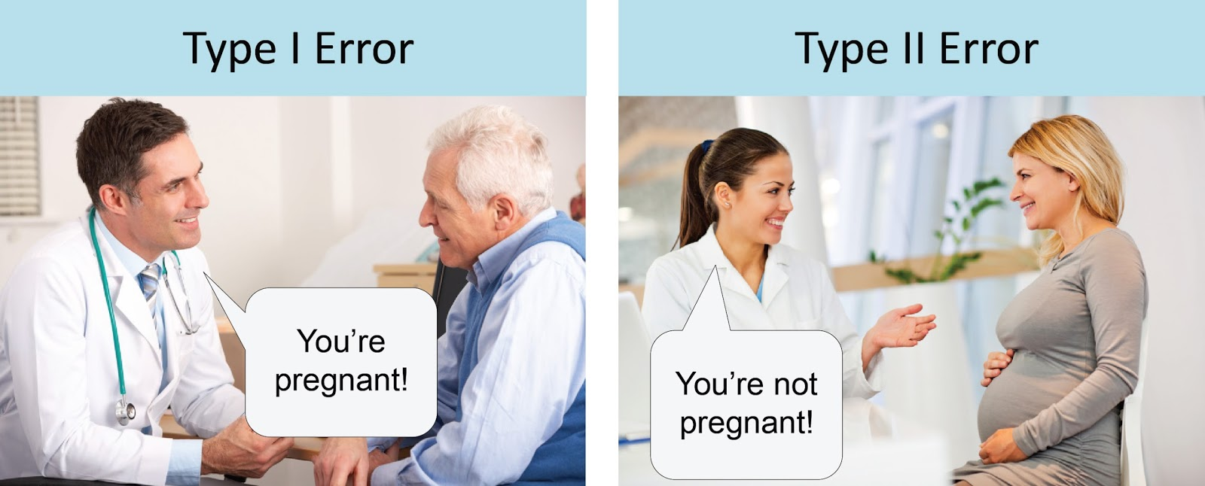
TYPES OF ERRORS

Slide 44
P-VALUES

Slide 45
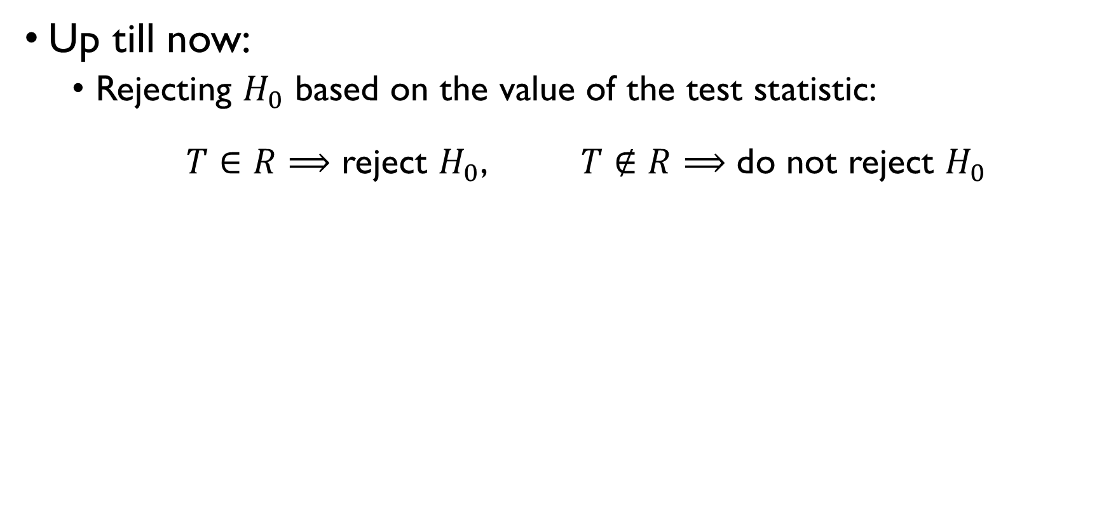
P-VALUES
Up till now:
Rejecting $H_{0}$ based on the value of the test statistic:
$T∈R⟹$ reject $H_{0}$, $T∉R⟹$ do not reject $H_{0}$
Not very practical:
The value of the test statistic alone isn’t informative.
Rejection region $R$ is different for every test.
A more unified approach: report p-value.

Slide 46
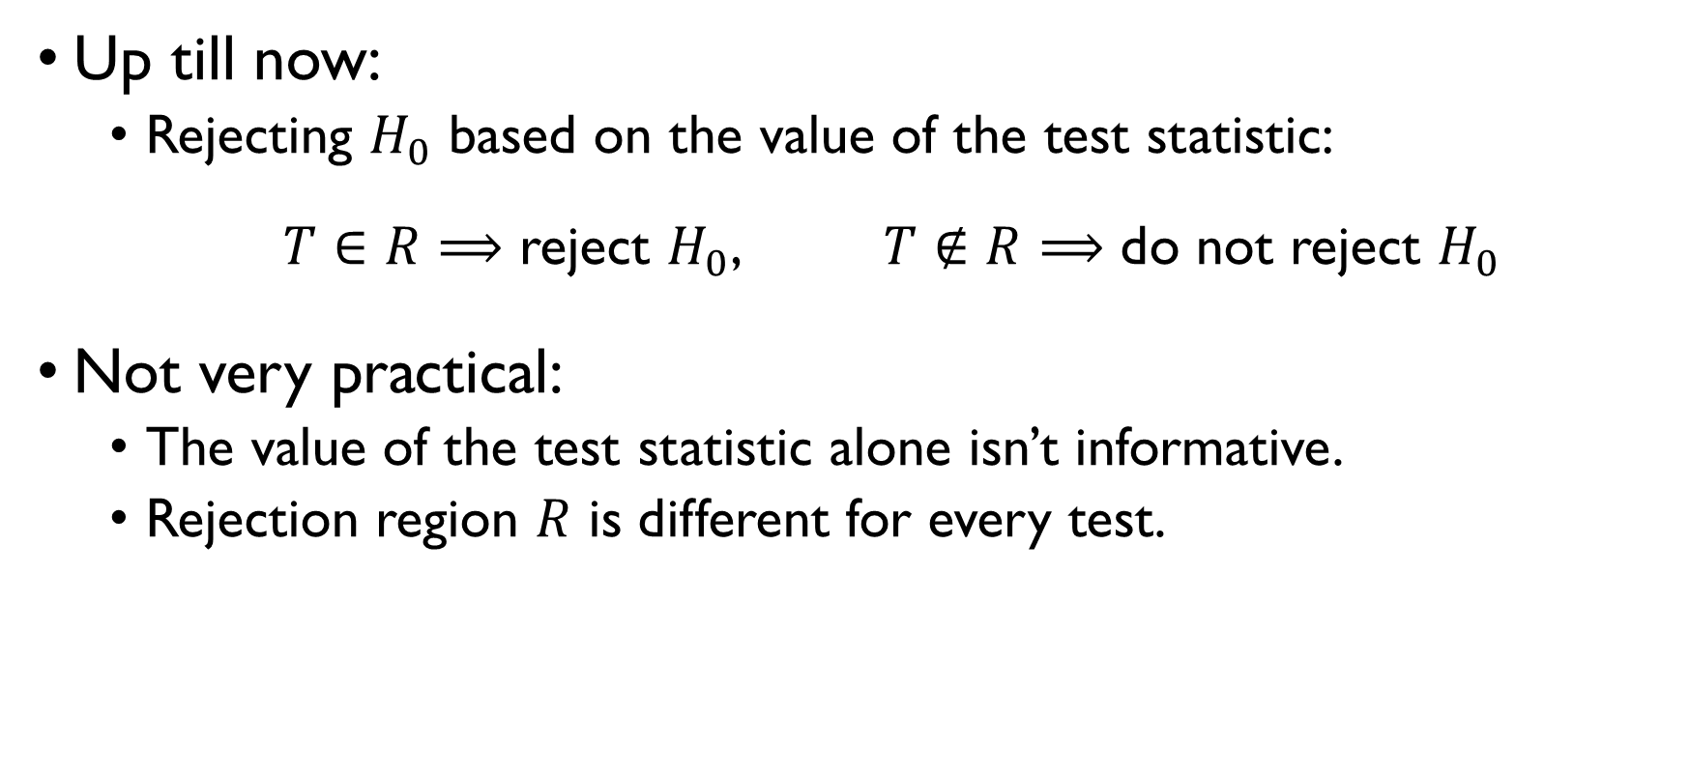
P-VALUES
Up till now:
Rejecting $H_{0}$ based on the value of the test statistic:
$T∈R⟹$ reject $H_{0}$, $T∉R⟹$ do not reject $H_{0}$
Not very practical:
The value of the test statistic alone isn’t informative.
Rejection region $R$ is different for every test.
A more unified approach: report p-value.

Slide 47
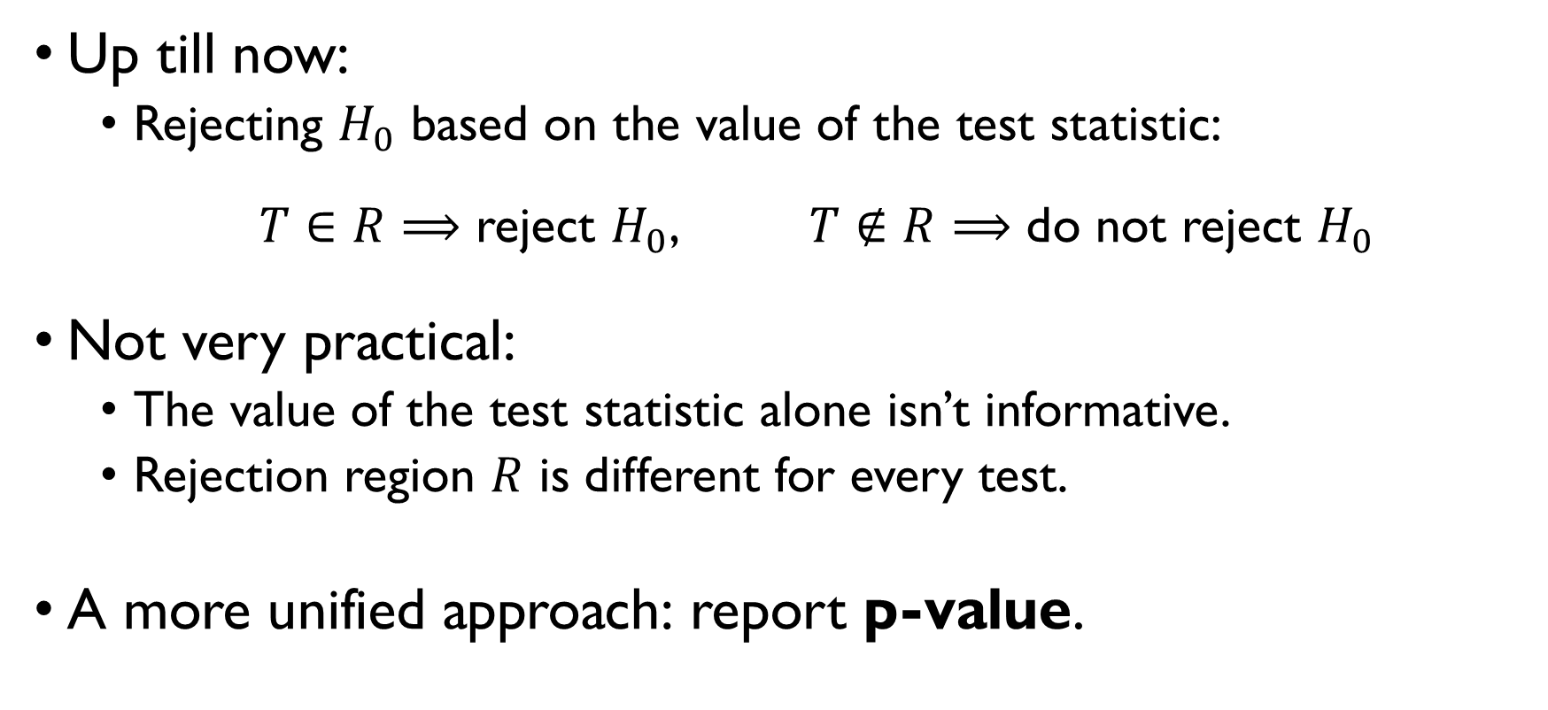
P-VALUES
Up till now:
Rejecting $H_{0}$ based on the value of the test statistic:
$T∈R⟹$ reject $H_{0}$, $T∉R⟹$ do not reject $H_{0}$
Not very practical:
The value of the test statistic alone isn’t informative.
Rejection region $R$ is different for every test.
A more unified approach: report p-value.

Slide 48
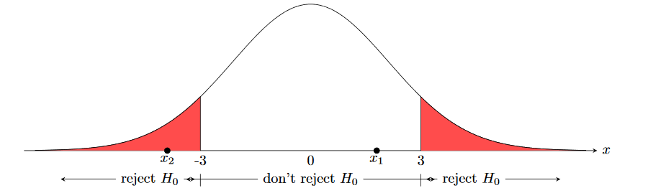
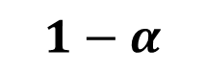
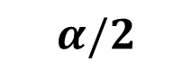
P-VALUES
$$1−α$$
$$α/2$$
$$α/2$$

Slide 49
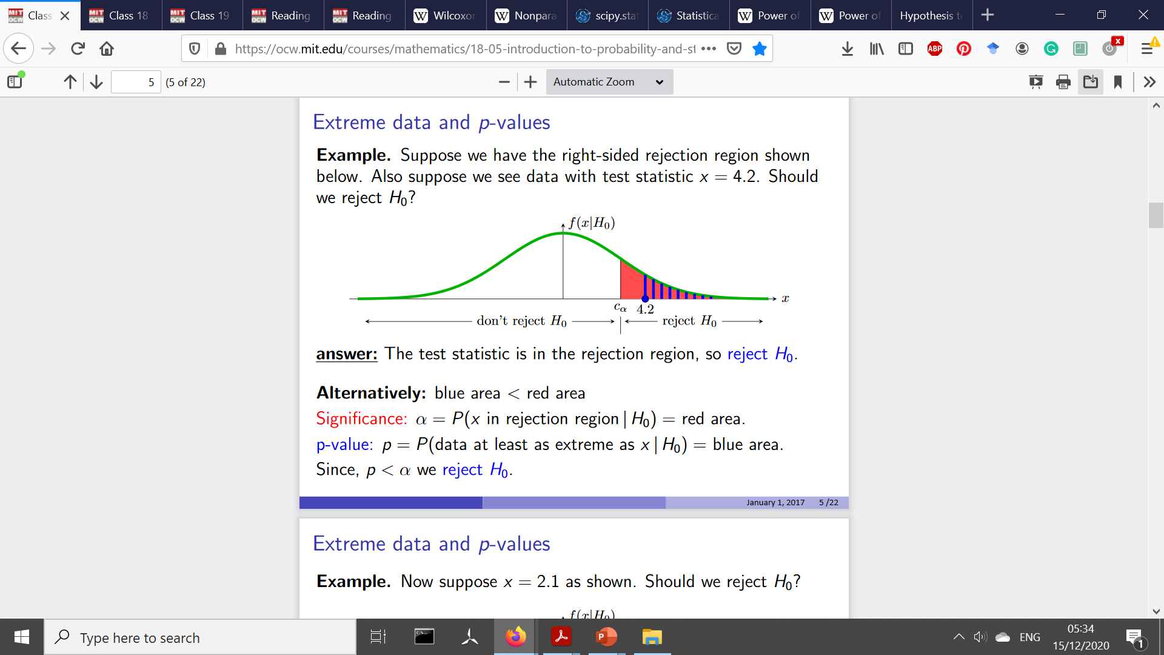
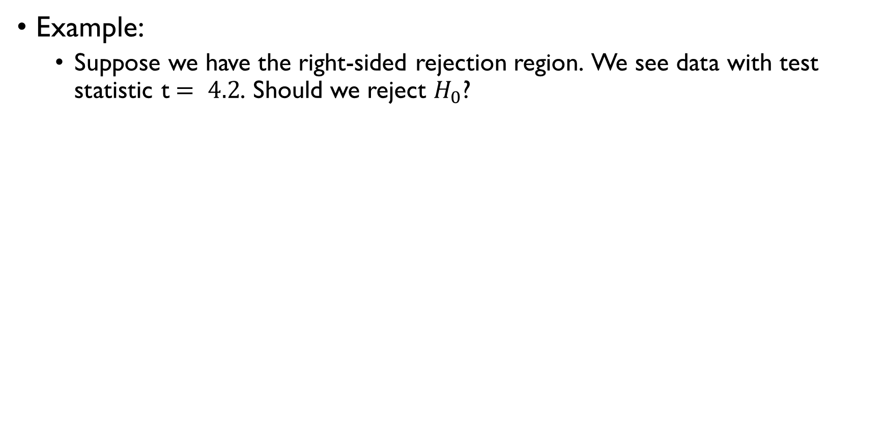
P-VALUES
Example:
Suppose we have the right-sided rejection region. We see data with test statistic t$= 4.2$. Should we reject $H_{0}$?
Answer:
Yes, if $T = 4.2$ is in the rejection region.
Alternatively:
Yes, if blue area < red area

Slide 50
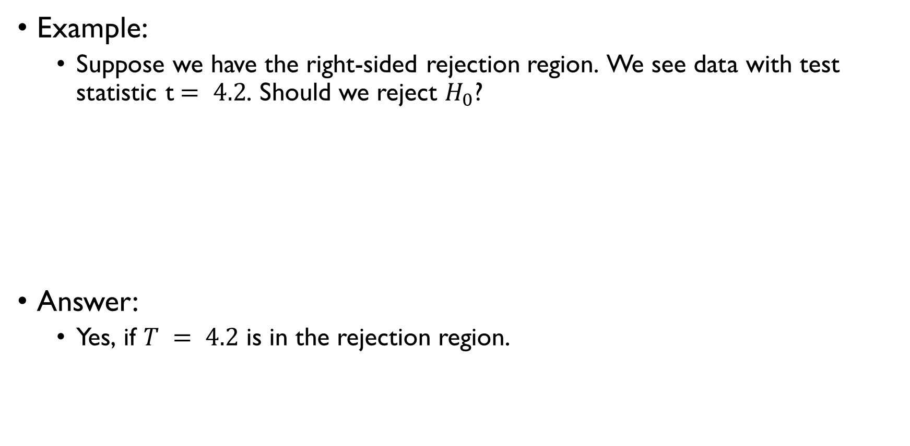
P-VALUES
Example:
Suppose we have the right-sided rejection region. We see data with test statistic t$= 4.2$. Should we reject $H_{0}$?
Answer:
Yes, if $T = 4.2$ is in the rejection region.
Alternatively:
Yes, if blue area < red area

Slide 51
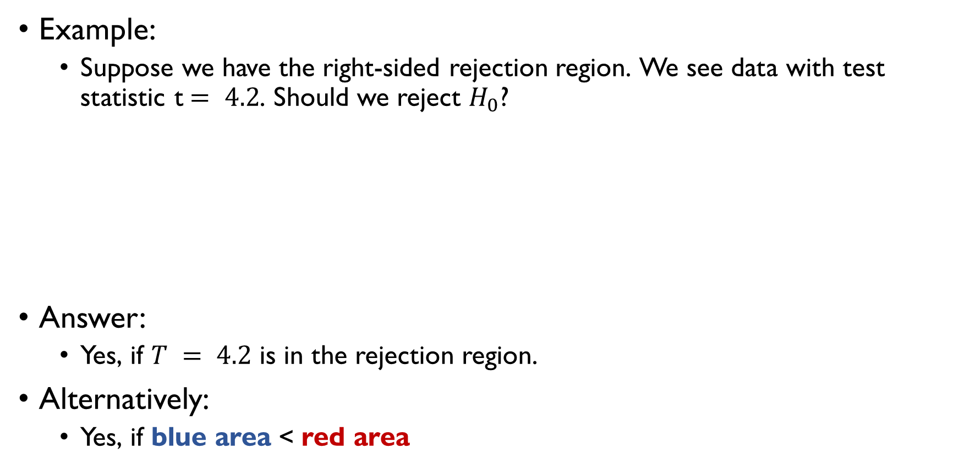
P-VALUES
Example:
Suppose we have the right-sided rejection region. We see data with test statistic t$= 4.2$. Should we reject $H_{0}$?
Answer:
Yes, if $T = 4.2$ is in the rejection region.
Alternatively:
Yes, if blue area < red area

Slide 52
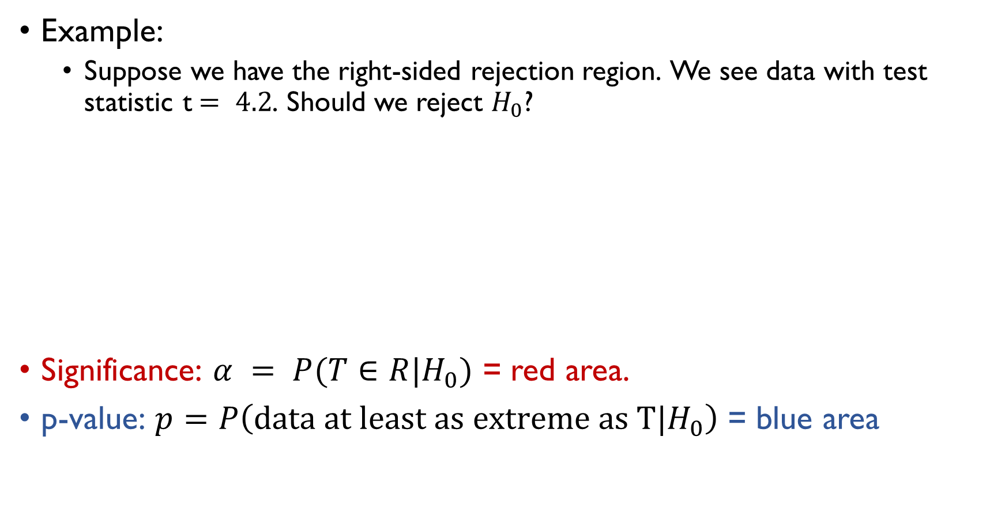
P-VALUES
Example:
Suppose we have the right-sided rejection region. We see data with test statistic t$= 4.2$. Should we reject $H_{0}$?
Significance: $α = P(T∈R|H_{0})$ = red area.
p-value: $p=P\left(data at least as extreme as T|H_{0}\right)$ = blue area
Since $p<α$, reject $H_{0}$

Slide 53
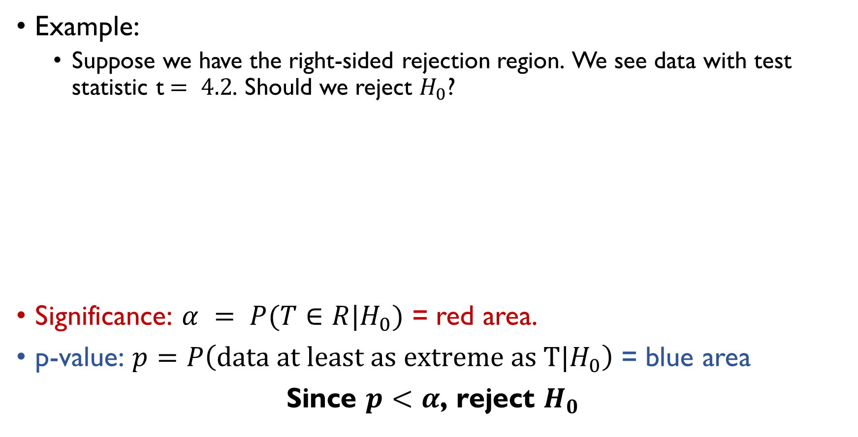
P-VALUES
Example:
Suppose we have the right-sided rejection region. We see data with test statistic t$= 4.2$. Should we reject $H_{0}$?
Significance: $α = P(T∈R|H_{0})$ = red area.
p-value: $p=P\left(data at least as extreme as T|H_{0}\right)$ = blue area
Since $p<α$, reject $H_{0}$

Slide 54
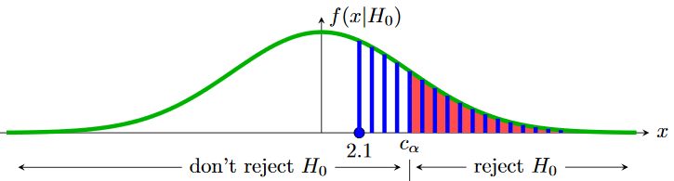
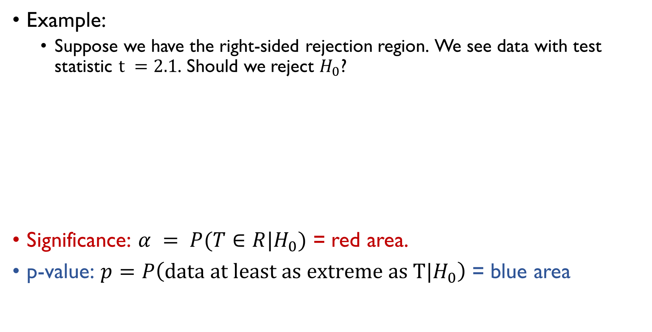
P-VALUES
Example:
Suppose we have the right-sided rejection region. We see data with test statistic $t =2.1$. Should we reject $H_{0}$?
Significance: $α = P(T∈R|H_{0})$ = red area.
p-value: $p=P\left(data at least as extreme as T|H_{0}\right)$ = blue area
Since $p>α$, do not reject $H_{0}$

Slide 55

P-VALUES
Example:
Suppose we have the right-sided rejection region. We see data with test statistic $t =2.1$. Should we reject $H_{0}$?
Significance: $α = P(T∈R|H_{0})$ = red area.
p-value: $p=P\left(data at least as extreme as T|H_{0}\right)$ = blue area
Since $p>α$, do not reject $H_{0}$

Slide 56
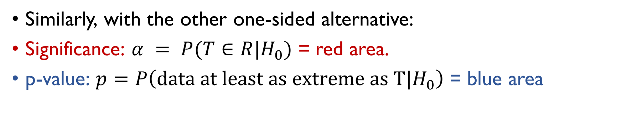
P-VALUES
Similarly, with the other one-sided alternative:
Significance: $α = P(T∈R|H_{0})$ = red area.
p-value: $p=P\left(data at least as extreme as T|H_{0}\right)$ = blue area
Since $p<α$, reject $H_{0}$

Slide 57
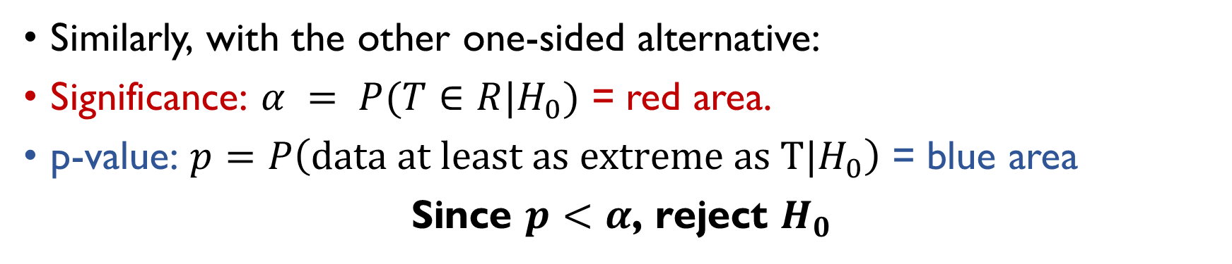
P-VALUES
Similarly, with the other one-sided alternative:
Significance: $α = P(T∈R|H_{0})$ = red area.
p-value: $p=P\left(data at least as extreme as T|H_{0}\right)$ = blue area
Since $p<α$, reject $H_{0}$

Slide 58
P-VALUES
Two-sided p-values are a bit trickier:
What does ‘data at least as extreme’ means in this context?

Slide 59


P-VALUES
Two-sided p-values are a bit trickier:
What does ‘data at least as extreme’ means in this context?
$$p=2\min\left\{P\left(T>t\right),P\left(T≤t\right)\right\}$$

Slide 60

P-VALUES
Two-sided p-values are a bit trickier:
What does ‘data at least as extreme’ means in this context?
$$p=2\min\left\{P\left(T>t\right),P\left(T≤t\right)\right\}$$

Slide 61

P-VALUES
Two-sided p-values are a bit trickier:
What does ‘data at least as extreme’ means in this context?
$$p=2\min\left\{P\left(T>t\right),P\left(T≤t\right)\right\}$$

Slide 62

P-VALUES
Summing it up:
if $t$ is the value of test statistic, $p=…$
One-sided alternative (‘greater,’ right tail): $p=P\left(T>t\right)$
One-sided alternative (‘smaller’, left tail): $p=P\left(T≤t\right)$
Two-sided alternative: $p=2\min\left\{P\left(T>t\right),P\left(T≤t\right)\right\}$
$p<α ⟹$ Reject $H_{0}$

Slide 63

P-VALUES
Summing it up:
if $t$ is the value of test statistic, $p=…$
One-sided alternative (‘greater,’ right tail): $p=P\left(T>t\right)$
One-sided alternative (‘smaller’, left tail): $p=P\left(T≤t\right)$
Two-sided alternative: $p=2\min\left\{P\left(T>t\right),P\left(T≤t\right)\right\}$
$p<α ⟹$ Reject $H_{0}$

Slide 64

P-VALUES
Summing it up:
if $t$ is the value of test statistic, $p=…$
One-sided alternative (‘greater,’ right tail): $p=P\left(T>t\right)$
One-sided alternative (‘smaller’, left tail): $p=P\left(T≤t\right)$
Two-sided alternative: $p=2\min\left\{P\left(T>t\right),P\left(T≤t\right)\right\}$
$p<α ⟹$ Reject $H_{0}$

Slide 65

P-VALUES
Summing it up:
if $t$ is the value of test statistic, $p=…$
One-sided alternative (‘greater,’ right tail): $p=P\left(T>t\right)$
One-sided alternative (‘smaller’, left tail): $p=P\left(T≤t\right)$
Two-sided alternative: $p=2\min\left\{P\left(T>t\right),P\left(T≤t\right)\right\}$
$p<α ⟹$ Reject $H_{0}$

Slide 66

P-VALUES
Summing it up:
if $t$ is the value of test statistic, $p=…$
One-sided alternative (‘greater,’ right tail): $p=P\left(T>t\right)$
One-sided alternative (‘smaller’, left tail): $p=P\left(T≤t\right)$
Two-sided alternative: $p=2\min\left\{P\left(T>t\right),P\left(T≤t\right)\right\}$
$p<α ⟹$ Reject $H_{0}$

Slide 67
PRACTICE!
Google Classroom -> Lecture 11 -> One-sample tests

Slide 68
MORE TESTS

Slide 69
MORE TESTS
There exist a lot of tests.
Don’t try to memorize all the tests – there’re too many of them.
Your task is to find the right test when you need it.
Here are some of the most used ones (but not all).

Slide 70
TWO-SAMPLE TESTS

Slide 71
TWO-SAMPLE TESTS
Consider the task of comparing the means of two independent samples.
Examples:
comparing the mean efficacies of two medical treatments;
comparing academic performance in two different groups;

Slide 72
TWO-SAMPLE TESTS
Consider the task of comparing the means of two independent samples.
Examples:
comparing the mean efficacies of two medical treatments;
comparing academic performance in two different groups;

Slide 73
TWO-SAMPLE T-TESTS
Test difference in the means of two populations with unknown but equal variances

Slide 74

TWO-SAMPLE T-TEST
Two sets of data drawn from normal distribution (i.i.d.):
$$X_{1},X_{2},…,X_{n} \sim N\left(μ_{X},σ^{2}\right)$$
$$Y_{1},Y_{2},…,Y_{m} \sim N\left(μ_{Y},σ^{2}\right)$$
Means $μ_{X}$ and $μ_{Y}$and the variance $σ^{2}$are unknown.
Note that the two distributions have the same variance.
Null hypothesis: $H_{0}: μ_{X}−μ_{Y}=0$
Alternatives:
Two-sided: $H_{1}: μ_{X}−μ_{Y}≠0$
One-sided: $H_{1}: μ_{X}−μ_{Y}>0$ or $H_{1}: μ_{X}−μ_{Y}<0$

Slide 75

TWO-SAMPLE T-TEST
Two sets of data drawn from normal distribution (i.i.d.):
$$X_{1},X_{2},…,X_{n} \sim N\left(μ_{X},σ^{2}\right)$$
$$Y_{1},Y_{2},…,Y_{m} \sim N\left(μ_{Y},σ^{2}\right)$$
Means $μ_{X}$ and $μ_{Y}$and the variance $σ^{2}$are unknown.
Note that the two distributions have the same variance.
Null hypothesis: $H_{0}: μ_{X}−μ_{Y}=0$
Alternatives:
Two-sided: $H_{1}: μ_{X}−μ_{Y}≠0$
One-sided: $H_{1}: μ_{X}−μ_{Y}>0$ or $H_{1}: μ_{X}−μ_{Y}<0$

Slide 76

TWO-SAMPLE T-TEST
Two sets of data drawn from normal distribution (i.i.d.):
$$X_{1},X_{2},…,X_{n} \sim N\left(μ_{X},σ^{2}\right)$$
$$Y_{1},Y_{2},…,Y_{m} \sim N\left(μ_{Y},σ^{2}\right)$$
Means $μ_{X}$ and $μ_{Y}$and the variance $σ^{2}$are unknown.
Note that the two distributions have the same variance.
Null hypothesis: $H_{0}: μ_{X}−μ_{Y}=0$
Alternatives:
Two-sided: $H_{1}: μ_{X}−μ_{Y}≠0$
One-sided: $H_{1}: μ_{X}−μ_{Y}>0$ or $H_{1}: μ_{X}−μ_{Y}<0$

Slide 77

TWO-SAMPLE T-TEST
Test statistic:
$T\left(X,Y\right)=\frac{\overline{X}−\overline{Y}}{s_{p}}$ , where
$$s_{p}^{2}=\frac{\left(n−1\right)s_{X}^{2}+\left(m−1\right)s_{Y}^{2}}{n+m−2}∙\left(\frac{1}{n}+\frac{1}{m}\right)$$
$s_{X}^{2},s_{Y}^{2}$ - sample variances of $X$ and $Y$.
Null distribution:
$$\frac{\overline{X}−\overline{Y}}{s_{p}} \sim t\left(n+m−2\right)$$

Slide 78

TWO-SAMPLE T-TEST
Test statistic:
$T\left(X,Y\right)=\frac{\overline{X}−\overline{Y}}{s_{p}}$ , where
$$s_{p}^{2}=\frac{\left(n−1\right)s_{X}^{2}+\left(m−1\right)s_{Y}^{2}}{n+m−2}∙\left(\frac{1}{n}+\frac{1}{m}\right)$$
$s_{X}^{2},s_{Y}^{2}$ - sample variances of $X$ and $Y$.
Null distribution:
$$\frac{\overline{X}−\overline{Y}}{s_{p}} \sim t\left(n+m−2\right)$$

Slide 79

TWO-SAMPLE T-TEST: EXAMPLE
Women admitted to maternity hospital, weeks of pregnancy measured in two groups.
Medical: $n=775, \overline{X}=39.08, s_{X}^{2}=7.77$
Emergency: $m=633, \overline{Y}=39.60, s_{Y}^{2}=4.95$
Set up and run two-sample t-test to check if the mean duration of pregnancy differs in the two groups.
Which assumptions do you have to make?

Slide 80

TWO-SAMPLE T-TEST: EXAMPLE
Women admitted to maternity hospital, weeks of pregnancy measured in two groups.
Medical: $n=775, \overline{X}=39.08, s_{X}^{2}=7.77$
Emergency: $m=633, \overline{Y}=39.60, s_{Y}^{2}=4.95$
$$H_{0}: μ_{x}−μ_{Y}=0$$
$$H_{1}: μ_{x}−μ_{Y}≠0$$

Slide 81

TWO-SAMPLE T-TEST: EXAMPLE
Women admitted to maternity hospital, weeks of pregnancy measured in two groups.
Medical: $n=775, \overline{X}=39.08, s_{X}^{2}=7.77$
Emergency: $m=633, \overline{Y}=39.60, s_{Y}^{2}=4.95$
$$H_{0}: μ_{x}−μ_{Y}=0$$
$$H_{1}: μ_{x}−μ_{Y}≠0$$

Slide 82

TWO-SAMPLE T-TEST: EXAMPLE
Women admitted to maternity hospital, weeks of pregnancy measured in two groups.
Medical: $n=775, \overline{X}=39.08, s_{X}^{2}=7.77$
Emergency: $m=633, \overline{Y}=39.60, s_{Y}^{2}=4.95$
$$T=\frac{\overline{X}−\overline{Y}}{s_{p}} \sim t\left(n+m−2\right)$$

Slide 83

TWO-SAMPLE T-TEST: EXAMPLE
Women admitted to maternity hospital, weeks of pregnancy measured in two groups.
Medical: $n=775, \overline{X}=39.08, s_{X}^{2}=7.77$
Emergency: $m=633, \overline{Y}=39.60, s_{Y}^{2}=4.95$
$$s_{p}^{2}=\frac{774∙7.77+632∙4.95}{775+633−2}\left(\frac{1}{775}+\frac{1}{633}\right)=0.0187$$

Slide 84

TWO-SAMPLE T-TEST: EXAMPLE
Women admitted to maternity hospital, weeks of pregnancy measured in two groups.
Medical: $n=775, \overline{X}=39.08, s_{X}^{2}=7.77$
Emergency: $m=633, \overline{Y}=39.60, s_{Y}^{2}=4.95$
$$s_{p}^{2}=\frac{774∙7.77+632∙4.95}{775+633−2}\left(\frac{1}{775}+\frac{1}{633}\right)=0.0187$$

Slide 85

TWO-SAMPLE T-TEST: EXAMPLE
Women admitted to maternity hospital, weeks of pregnancy measured in two groups.
Medical: $n=775, \overline{X}=39.08, s_{X}^{2}=7.77$
Emergency: $m=633, \overline{Y}=39.60, s_{Y}^{2}=4.95$
$$T=\frac{\overline{X}−\overline{Y}}{s_{p}}=\frac{39.08−39.60}{\sqrt{0.0187}}=−3.8064$$
$T\sim t\left(1408\right)≈N\left(0,1\right)$ P-value: $P\left(\left|T\right|>3.8064\right)<0.001$

Slide 86

TWO-SAMPLE T-TEST: EXAMPLE
Women admitted to maternity hospital, weeks of pregnancy measured in two groups.
Medical: $n=775, \overline{X}=39.08, s_{X}^{2}=7.77$
Emergency: $m=633, \overline{Y}=39.60, s_{Y}^{2}=4.95$
$$T=\frac{\overline{X}−\overline{Y}}{s_{p}}=\frac{39.08−39.60}{\sqrt{0.0187}}=−3.8064$$
$T\sim t\left(1408\right)≈N\left(0,1\right)$ P-value: $P\left(\left|T\right|>3.8064\right)<0.001$

Slide 87

TWO-SAMPLE T-TEST: EXAMPLE
Women admitted to maternity hospital, weeks of pregnancy measured in two groups.
Medical: $n=775, \overline{X}=39.08, s_{X}^{2}=7.77$
Emergency: $m=633, \overline{Y}=39.60, s_{Y}^{2}=4.95$
$$T=\frac{\overline{X}−\overline{Y}}{s_{p}}=\frac{39.08−39.60}{\sqrt{0.0187}}=−3.8064$$
$T\sim t\left(1408\right)≈N\left(0,1\right)$ P-value: $P\left(\left|T\right|>3.8064\right)<0.001$

Slide 88

TWO-SAMPLE T-TEST: EXAMPLE
Women admitted to maternity hospital, weeks of pregnancy measured in two groups.
Medical: $n=775, \overline{X}=39.08, s_{X}^{2}=7.77$
Emergency: $m=633, \overline{Y}=39.60, s_{Y}^{2}=4.95$
$H_{0}: μ_{x}−μ_{Y}=0−$ rejected
$$H_{1}: μ_{x}−μ_{Y}≠0$$

Slide 89
TWO-SAMPLE T-TEST: EXAMPLE
Assumptions made:
Length of pregnancy is normally distributed
Variances are the same in both groups – unrealistic
GOOD TO KNOW:
There’re special tests to check if the data is normal and if two groups have the same variances.
In practice, it’s good to apply them first to check the validity of the assumptions.

Slide 90
TWO-SAMPLE T-TEST: EXAMPLE
Assumptions made:
Length of pregnancy is normally distributed
Variances are the same in both groups – unrealistic
GOOD TO KNOW:
There’re special tests to check if the data is normal and if two groups have the same variances.
In practice, it’s good to apply them first to check the validity of the assumptions.

Slide 91
WELCH’S TESTS
The case of unequal variances

Slide 92

WELCH’S TEST
Two sets of data drawn from normal distribution (i.i.d.):
$$X_{1},X_{2},…,X_{n} \sim N\left(μ_{X},σ_{X}^{2}\right)$$
$$Y_{1},Y_{2},…,Y_{m} \sim N\left(μ_{Y},σ_{Y}^{2}\right)$$
Means $μ_{X}$ and $μ_{Y}$and the variances $σ_{X}^{2}$and $σ_{Y}^{2}$ are unknown.
Note that the variances aren’t assumed to be equal.
Null hypothesis: $H_{0}: μ_{X}−μ_{Y}=0$
Alternatives:
Two-sided: $H_{1}: μ_{X}−μ_{Y}≠0$
One-sided: $H_{1}: μ_{X}−μ_{Y}>0$ or $H_{1}: μ_{X}−μ_{Y}<0$

Slide 93

WELCH’S TEST
Two sets of data drawn from normal distribution (i.i.d.):
$$X_{1},X_{2},…,X_{n} \sim N\left(μ_{X},σ_{X}^{2}\right)$$
$$Y_{1},Y_{2},…,Y_{m} \sim N\left(μ_{Y},σ_{Y}^{2}\right)$$
Means $μ_{X}$ and $μ_{Y}$and the variances $σ_{X}^{2}$and $σ_{Y}^{2}$ are unknown.
Note that the variances aren’t assumed to be equal.
Null hypothesis: $H_{0}: μ_{X}−μ_{Y}=0$
Alternatives:
Two-sided: $H_{1}: μ_{X}−μ_{Y}≠0$
One-sided: $H_{1}: μ_{X}−μ_{Y}>0$ or $H_{1}: μ_{X}−μ_{Y}<0$

Slide 94

WELCH’S TEST
Two sets of data drawn from normal distribution (i.i.d.):
$$X_{1},X_{2},…,X_{n} \sim N\left(μ_{X},σ_{X}^{2}\right)$$
$$Y_{1},Y_{2},…,Y_{m} \sim N\left(μ_{Y},σ_{Y}^{2}\right)$$
Means $μ_{X}$ and $μ_{Y}$and the variances $σ_{X}^{2}$and $σ_{Y}^{2}$ are unknown.
Note that the variances aren’t assumed to be equal.
Null hypothesis: $H_{0}: μ_{X}−μ_{Y}=0$
Alternatives:
Two-sided: $H_{1}: μ_{X}−μ_{Y}≠0$
One-sided: $H_{1}: μ_{X}−μ_{Y}>0$ or $H_{1}: μ_{X}−μ_{Y}<0$

Slide 95

WELCH’S TEST
Test statistic:
$T\left(X,Y\right)=\frac{\overline{X}−\overline{Y}}{s_{p}}$ , where
$$s_{p}^{2}=\frac{s_{X}^{2}}{n}+\frac{s_{Y}^{2}}{m}, df=\frac{{\left({s_{X}^{2}}/n+{s_{Y}^{2}}/m\right)}^{2}}{{{\left({s_{X}^{2}}/n\right)}^{2}}/{\left(n−1\right)}+{{\left({s_{Y}^{2}}/m\right)}^{2}}/{\left(m−1\right)}}$$
$s_{X}^{2},s_{Y}^{2}$ - sample variances of $X$ and $Y$.
Null distribution:
$$\frac{\overline{X}−\overline{Y}}{s_{p}} \sim t\left(df\right)$$

Slide 96

WELCH’S TEST
Test statistic:
$T\left(X,Y\right)=\frac{\overline{X}−\overline{Y}}{s_{p}}$ , where
$$s_{p}^{2}=\frac{s_{X}^{2}}{n}+\frac{s_{Y}^{2}}{m}, df=\frac{{\left({s_{X}^{2}}/n+{s_{Y}^{2}}/m\right)}^{2}}{{{\left({s_{X}^{2}}/n\right)}^{2}}/{\left(n−1\right)}+{{\left({s_{Y}^{2}}/m\right)}^{2}}/{\left(m−1\right)}}$$
$s_{X}^{2},s_{Y}^{2}$ - sample variances of $X$ and $Y$.
Null distribution:
$$\frac{\overline{X}−\overline{Y}}{s_{p}} \sim t\left(df\right)$$

Slide 97
PAIRED SAMPLE T-TEST
Difference between the means when data comes in pairs

Slide 98

PAIRED DATA
Sometimes, data naturally comes in pairs $\left(X_{i},Y_{i}\right), i=1,…,n.$
“Repeated measures”:
patients’ condition before and after taking a new medication;
students’ performances before and after extra tutoring;
performance of two different algorithms on the same set of benchmarks.
Was there any effect?
Samples are paired = dependent.

Slide 99

PAIRED DATA
Sometimes, data naturally comes in pairs $\left(X_{i},Y_{i}\right), i=1,…,n.$
“Repeated measures”:
patients’ condition before and after taking a new medication;
students’ performances before and after extra tutoring;
performance of two different algorithms on the same set of benchmarks.
Was there any effect?
Samples are paired = dependent.

Slide 100

PAIRED DATA
Sometimes, data naturally comes in pairs $\left(X_{i},Y_{i}\right), i=1,…,n.$
“Repeated measures”:
patients’ condition before and after taking a new medication;
students’ performances before and after extra tutoring;
performance of two different algorithms on the same set of benchmarks.
Was there any effect?
Samples are paired = dependent.

Slide 101

PAIRED SAMPLE T-TEST
Two dependent sets of data drawn from normal distribution:
$$X_{1},X_{2},…,X_{n}, E\left(X_{i}\right)=μ_{X}$$
$$Y_{1},Y_{2},…,Y_{n}, E\left(Y_{i}\right)=μ_{Y}$$
Let’s introduce $D=X_{i}−Y_{i}$ Assumption: $D\sim N\left(μ,σ^{2}\right)$
FROM NOW, IT’S JUST A ONE-SAMPLE T-TEST IN TERMS OF $D$

Slide 102

PAIRED SAMPLE T-TEST
Two dependent sets of data drawn from normal distribution:
$$X_{1},X_{2},…,X_{n}, E\left(X_{i}\right)=μ_{X}$$
$$Y_{1},Y_{2},…,Y_{n}, E\left(Y_{i}\right)=μ_{Y}$$
Let’s introduce $D=X_{i}−Y_{i}$ Assumption: $D\sim N\left(μ,σ^{2}\right)$
FROM NOW, IT’S JUST A ONE-SAMPLE T-TEST IN TERMS OF $D$

Slide 103

PAIRED SAMPLE T-TEST
Two dependent sets of data drawn from normal distribution:
$$X_{1},X_{2},…,X_{n}, E\left(X_{i}\right)=μ_{X}$$
$$Y_{1},Y_{2},…,Y_{n}, E\left(Y_{i}\right)=μ_{Y}$$
Let’s introduce $D=X_{i}−Y_{i}$ Assumption: $D\sim N\left(μ,σ^{2}\right)$
FROM NOW, IT’S JUST A ONE-SAMPLE T-TEST IN TERMS OF $D$

Slide 104

PAIRED SAMPLE T-TEST
Two dependent sets of data drawn from normal distribution:
$$X_{1},X_{2},…,X_{n}, E\left(X_{i}\right)=μ_{X}$$
$$Y_{1},Y_{2},…,Y_{n}, E\left(Y_{i}\right)=μ_{Y}$$
Let’s introduce $D=X_{i}−Y_{i}$ Assumption: $D\sim N\left(μ,σ^{2}\right)$
Null hypothesis:
$$H_{0}: E\left(D\right)=μ=0$$
Alternatives:
Two-sided: $H_{1}:E\left(D\right)=μ≠0$
One-sided: $H_{1}:μ>0$ or $H_{1}:μ<0$

Slide 105

PAIRED SAMPLE T-TEST
Test statistic:
$$T\left(X,Y\right)=\frac{\overline{D}\sqrt{n}}{s},$$
$$s^{2}=\frac{1}{n−1}\sum_{i=1}^{n}{{\left(D_{i}−\overline{D}\right)}^{2}}$$
Null distribution:
$$T\left(X,Y\right)=\frac{\overline{D}\sqrt{n}}{s}\sim t\left(n−1\right)$$

Slide 106

PAIRED SAMPLE T-TEST
Test statistic:
$$T\left(X,Y\right)=\frac{\overline{D}\sqrt{n}}{s},$$
$$s^{2}=\frac{1}{n−1}\sum_{i=1}^{n}{{\left(D_{i}−\overline{D}\right)}^{2}}$$
Null distribution:
$$T\left(X,Y\right)=\frac{\overline{D}\sqrt{n}}{s}\sim t\left(n−1\right)$$

Slide 107

PAIRED SAMPLE T-TEST
Test statistic:
$$T\left(X,Y\right)=\frac{\overline{D}\sqrt{n}}{s},$$
$$s^{2}=\frac{1}{n−1}\sum_{i=1}^{n}{{\left(D_{i}−\overline{D}\right)}^{2}}$$
Null distribution:
$$T\left(X,Y\right)=\frac{\overline{D}\sqrt{n}}{s}\sim t\left(n−1\right)$$

